Slide 1
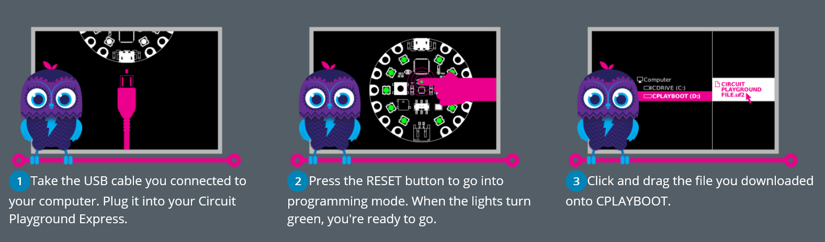

Slide 2
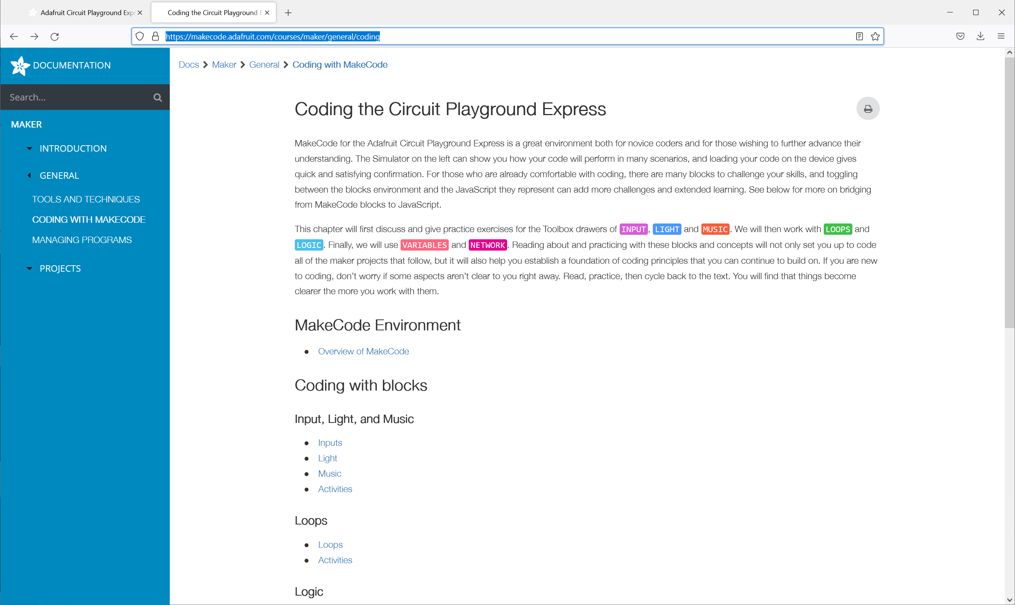
Notes:
https://makecode.adafruit.com/courses/maker/general/coding

Slide 3
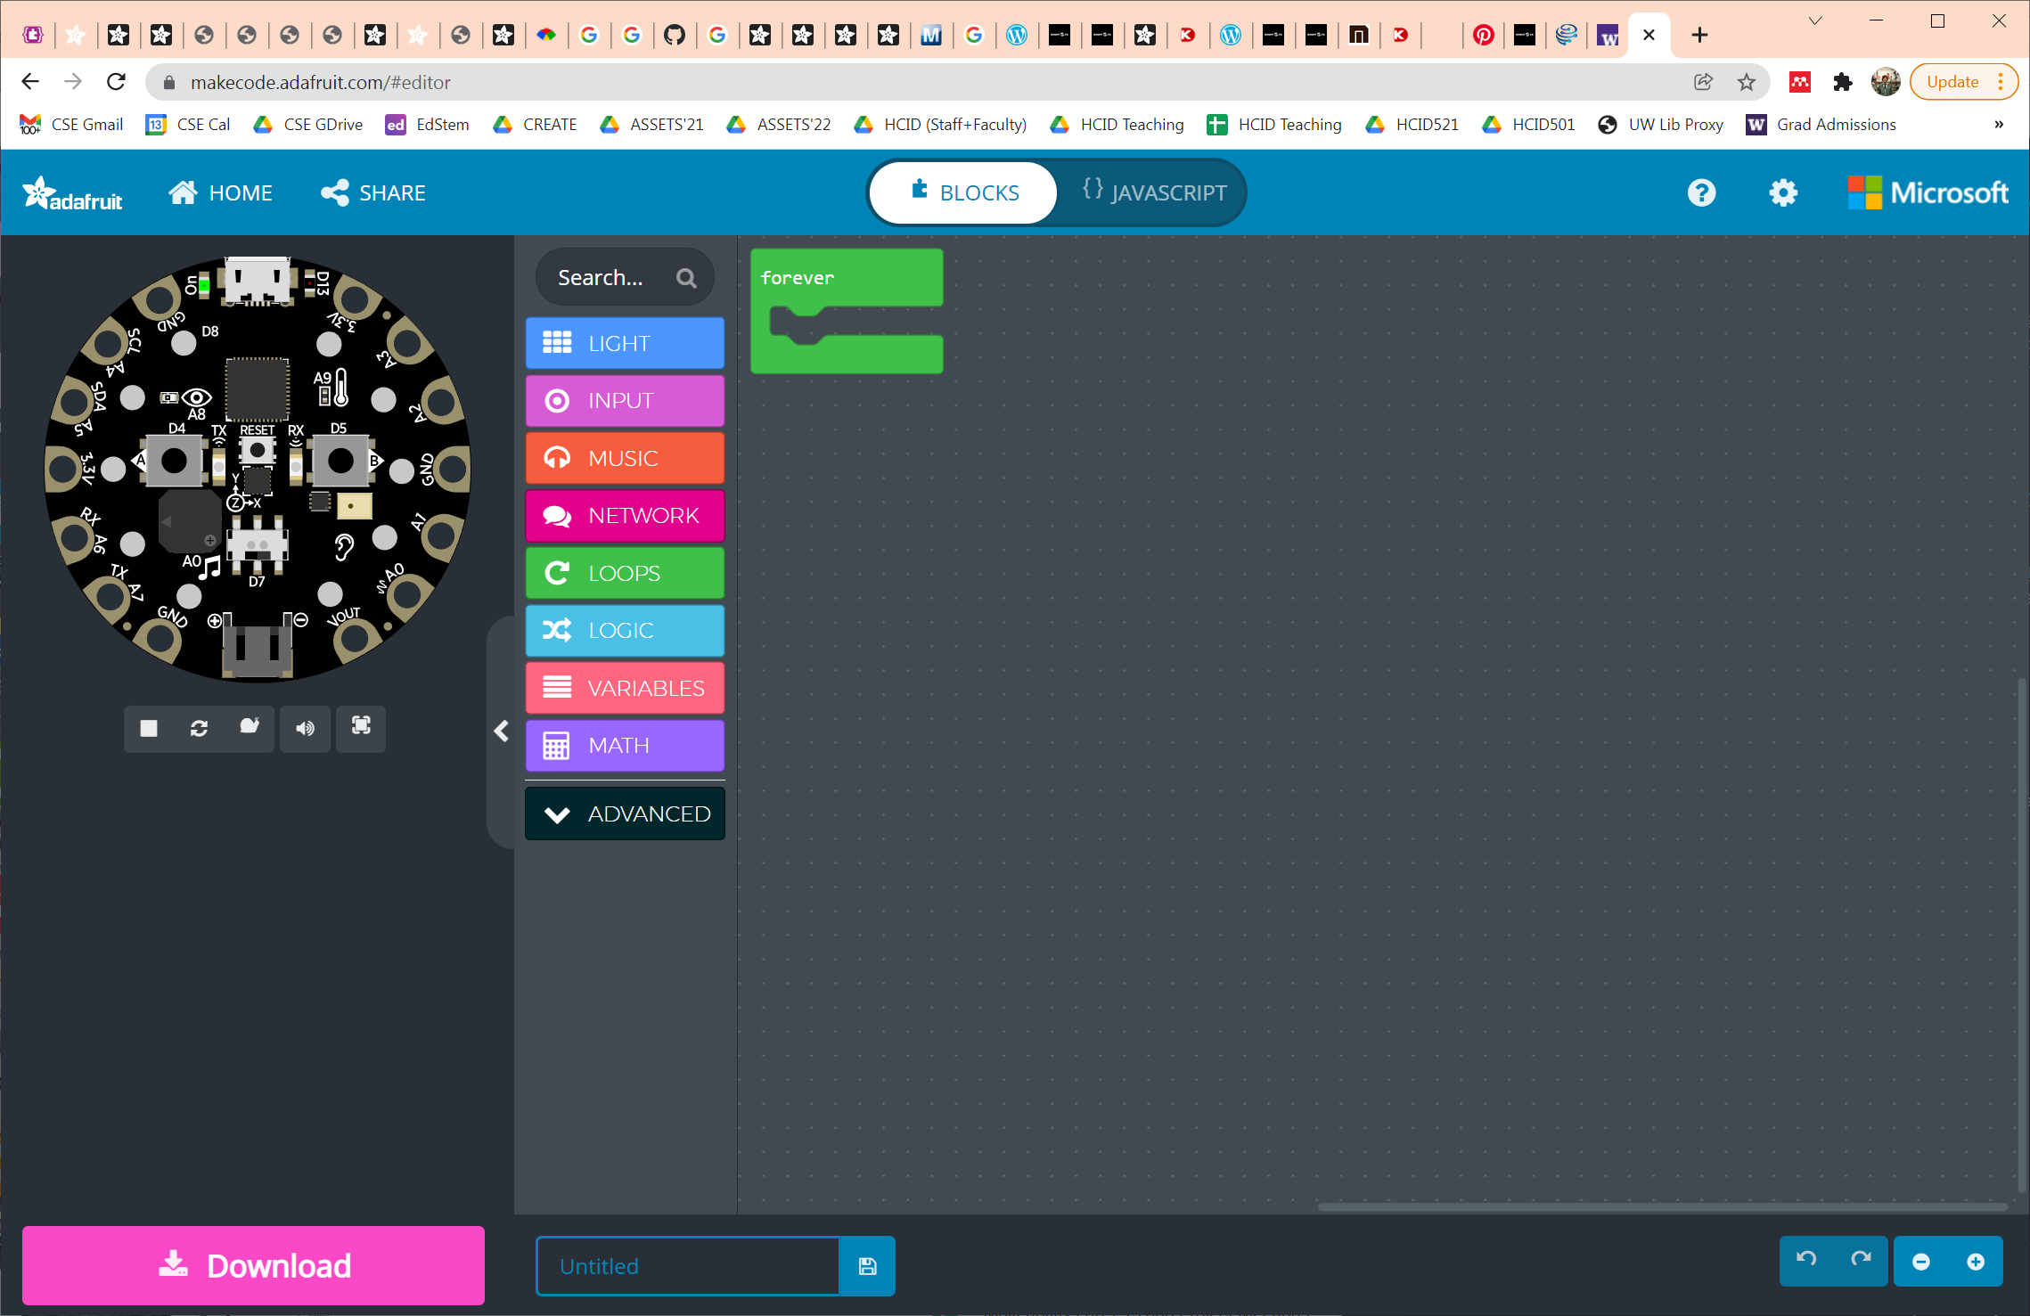

Slide 4
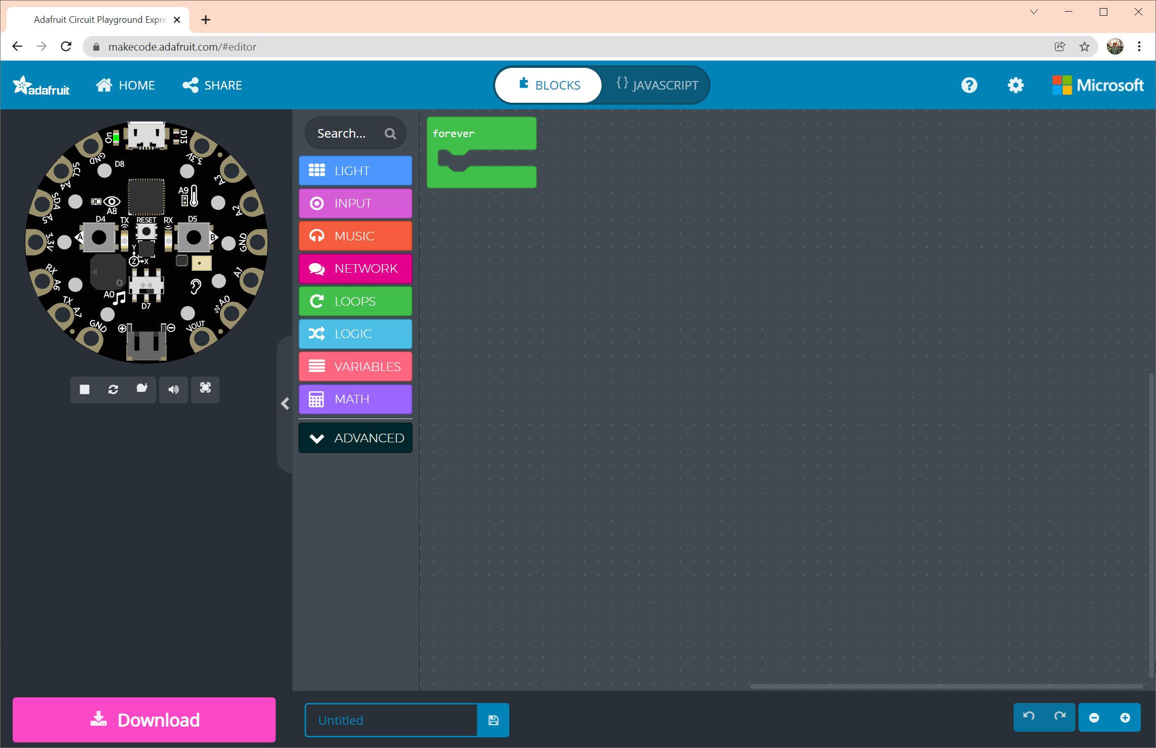

Slide 5
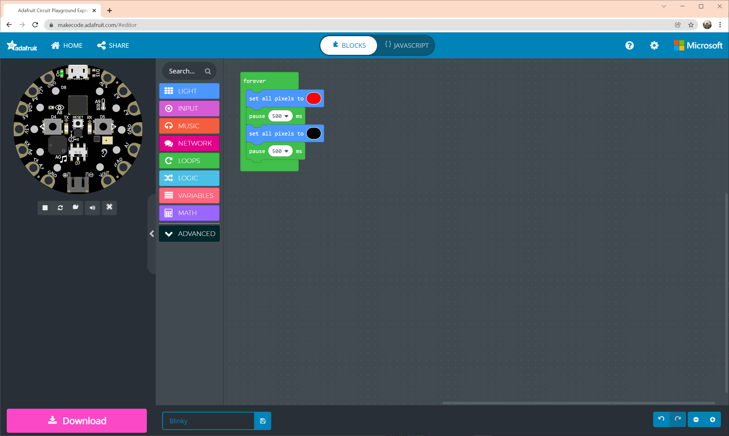
1
Programming workspace
3
Simulator
2
Toolbox

Slide 6
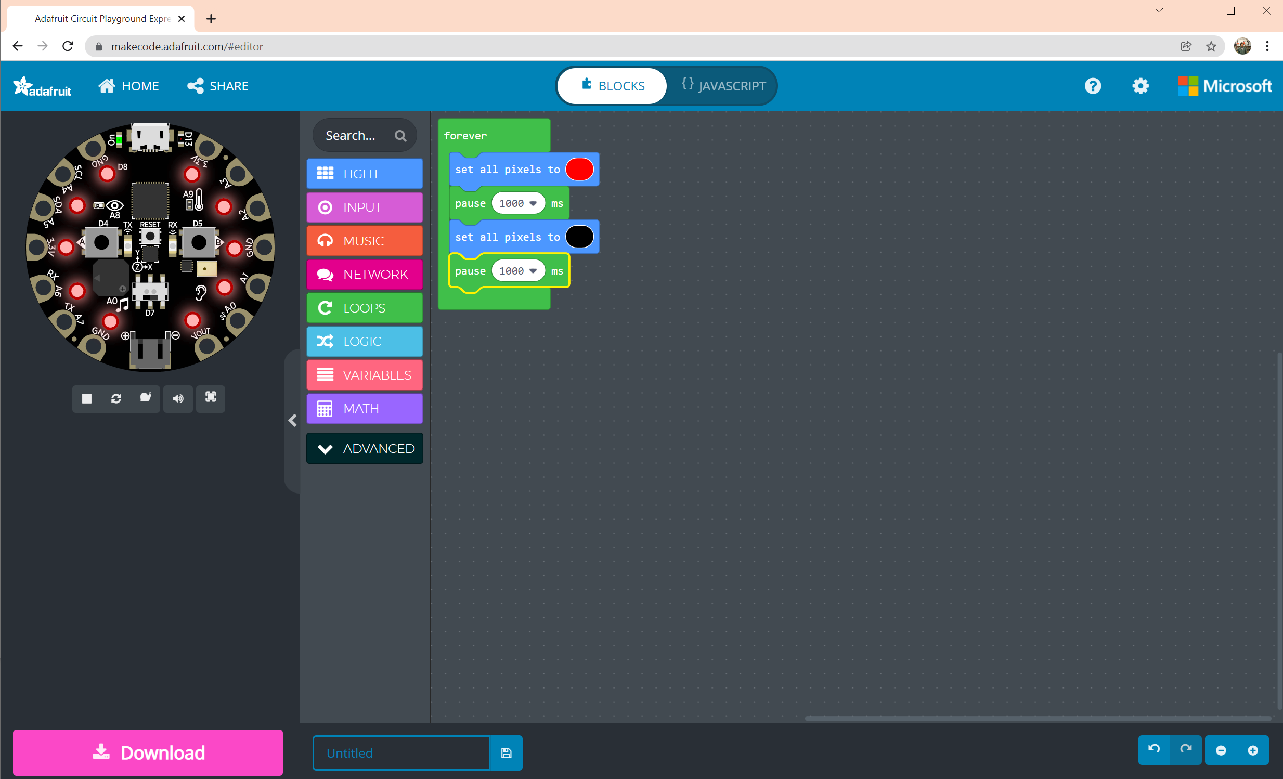

Slide 7
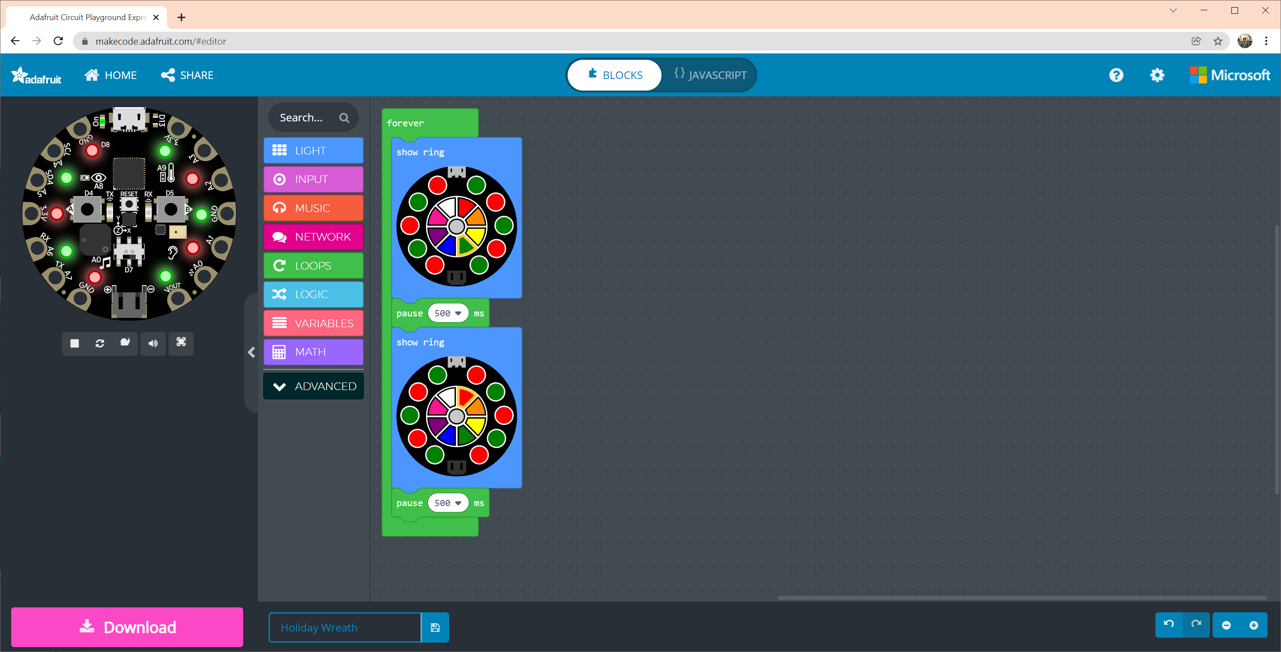
Notes:
forever(function () {
light.showRing(
`red green red green red green red green red green`
)
pause(500)
light.showRing(
`green red green red green red green red green red`
)
pause(500)
})

Slide 8
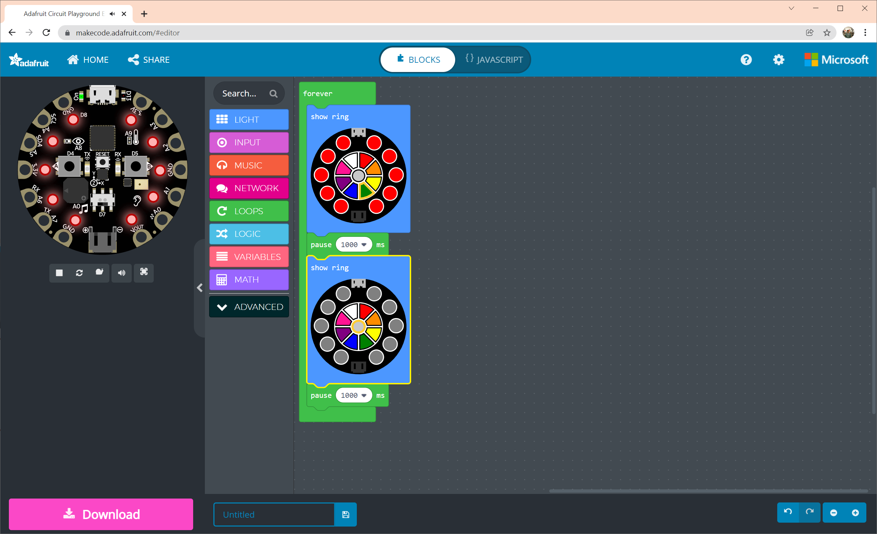

Slide 9
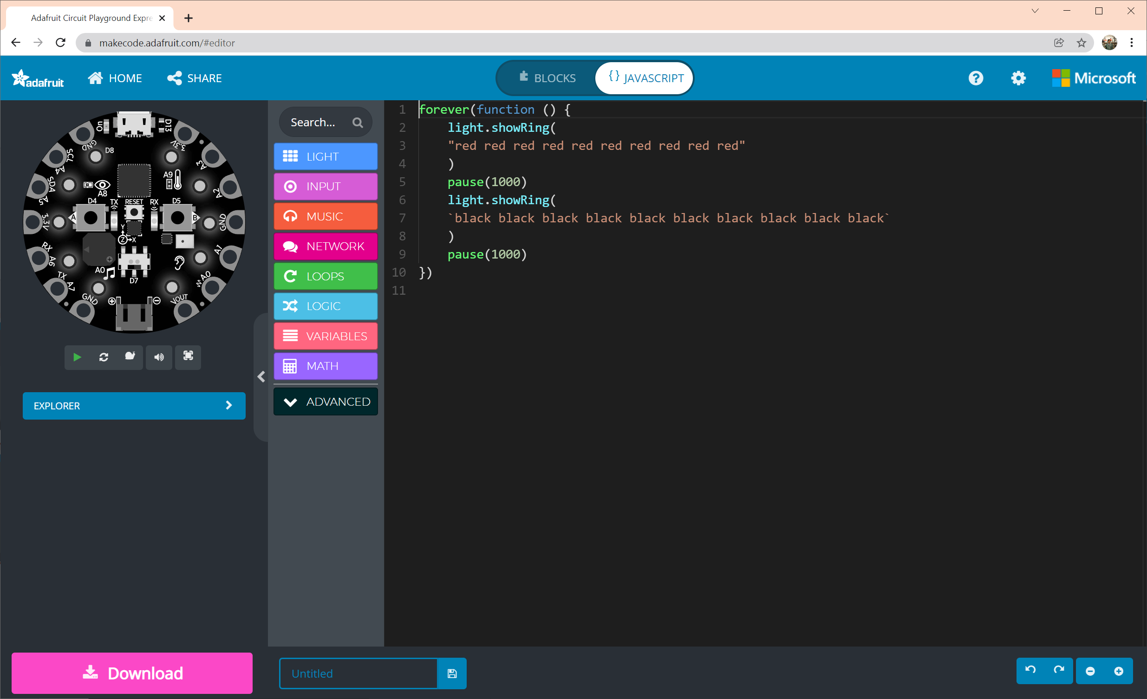
Notes:
forever(function () {
light.showRing(
"red red red red red red red red red red"
)
pause(1000)
light.showRing(
`black black black black black black black black black black`
)
pause(1000)
})

Slide 10
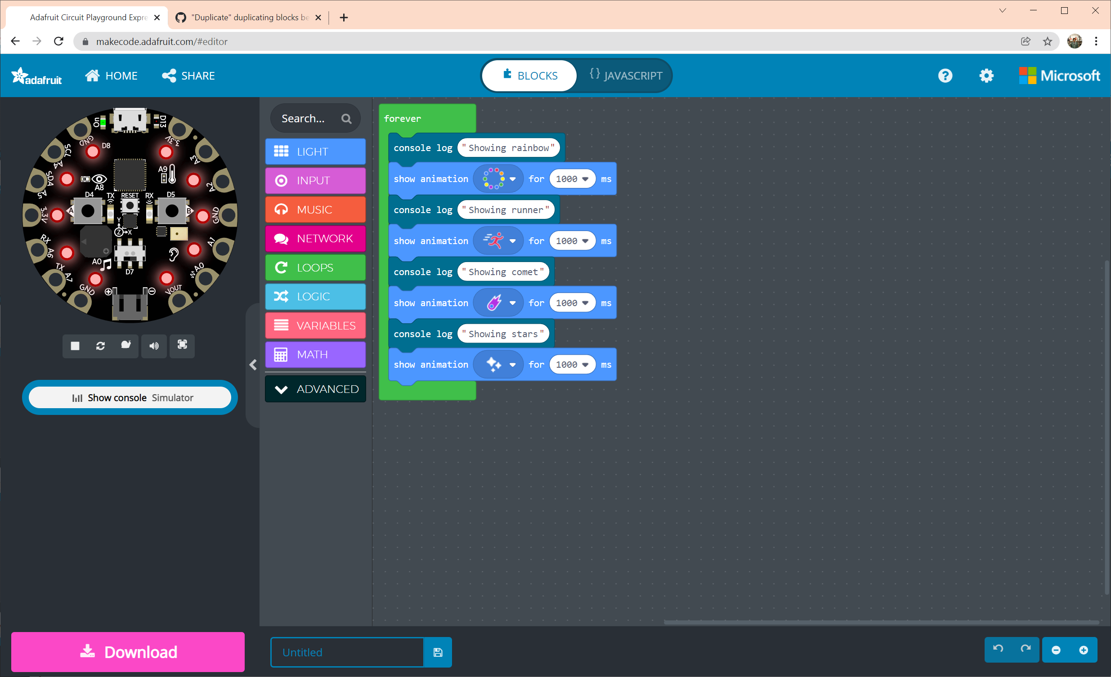
Notes:
Showing different animations with console outs
---
forever(function () {
console.log("Showing rainbow")
light.showAnimation(light.rainbowAnimation, 1000)
console.log("Showing runner")
light.showAnimation(light.runningLightsAnimation, 1000)
console.log("Showing comet")
light.showAnimation(light.cometAnimation, 1000)
console.log("Showing stars")
light.showAnimation(light.sparkleAnimation, 1000)
})

Slide 11
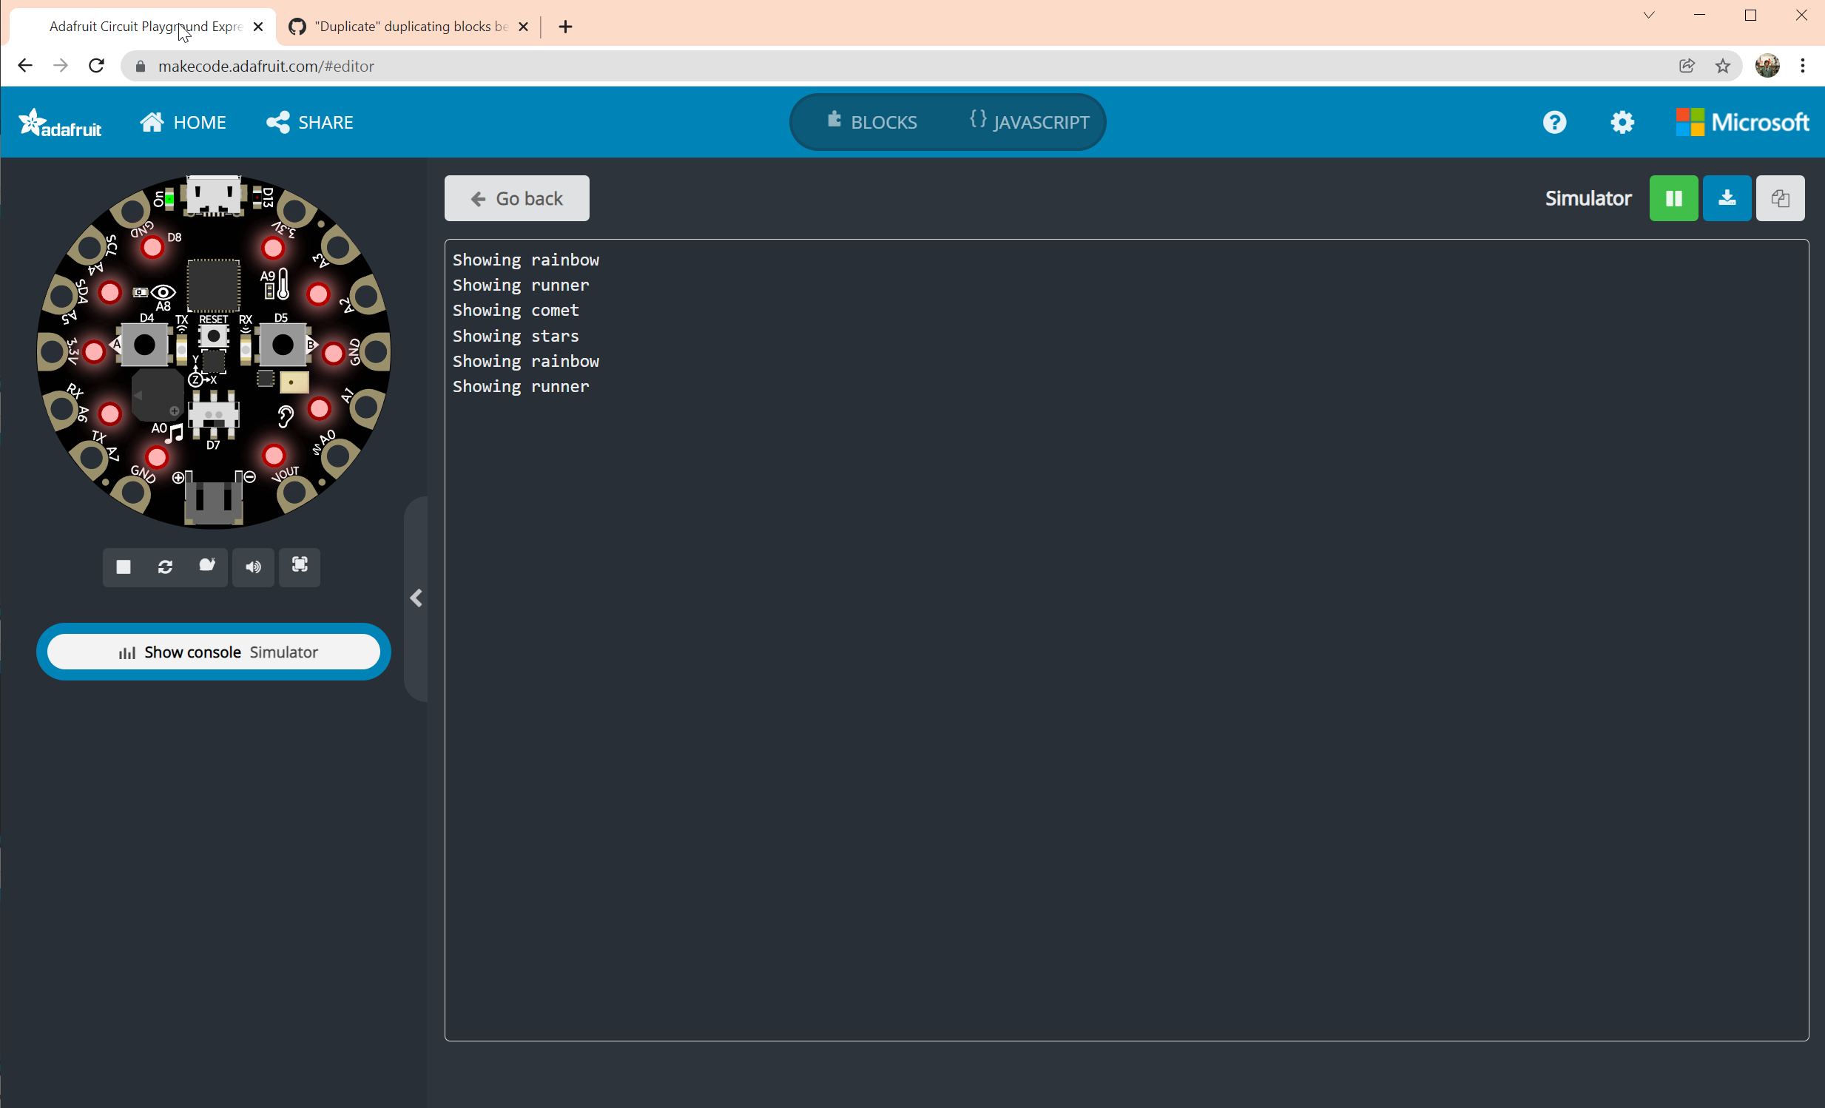

Slide 12
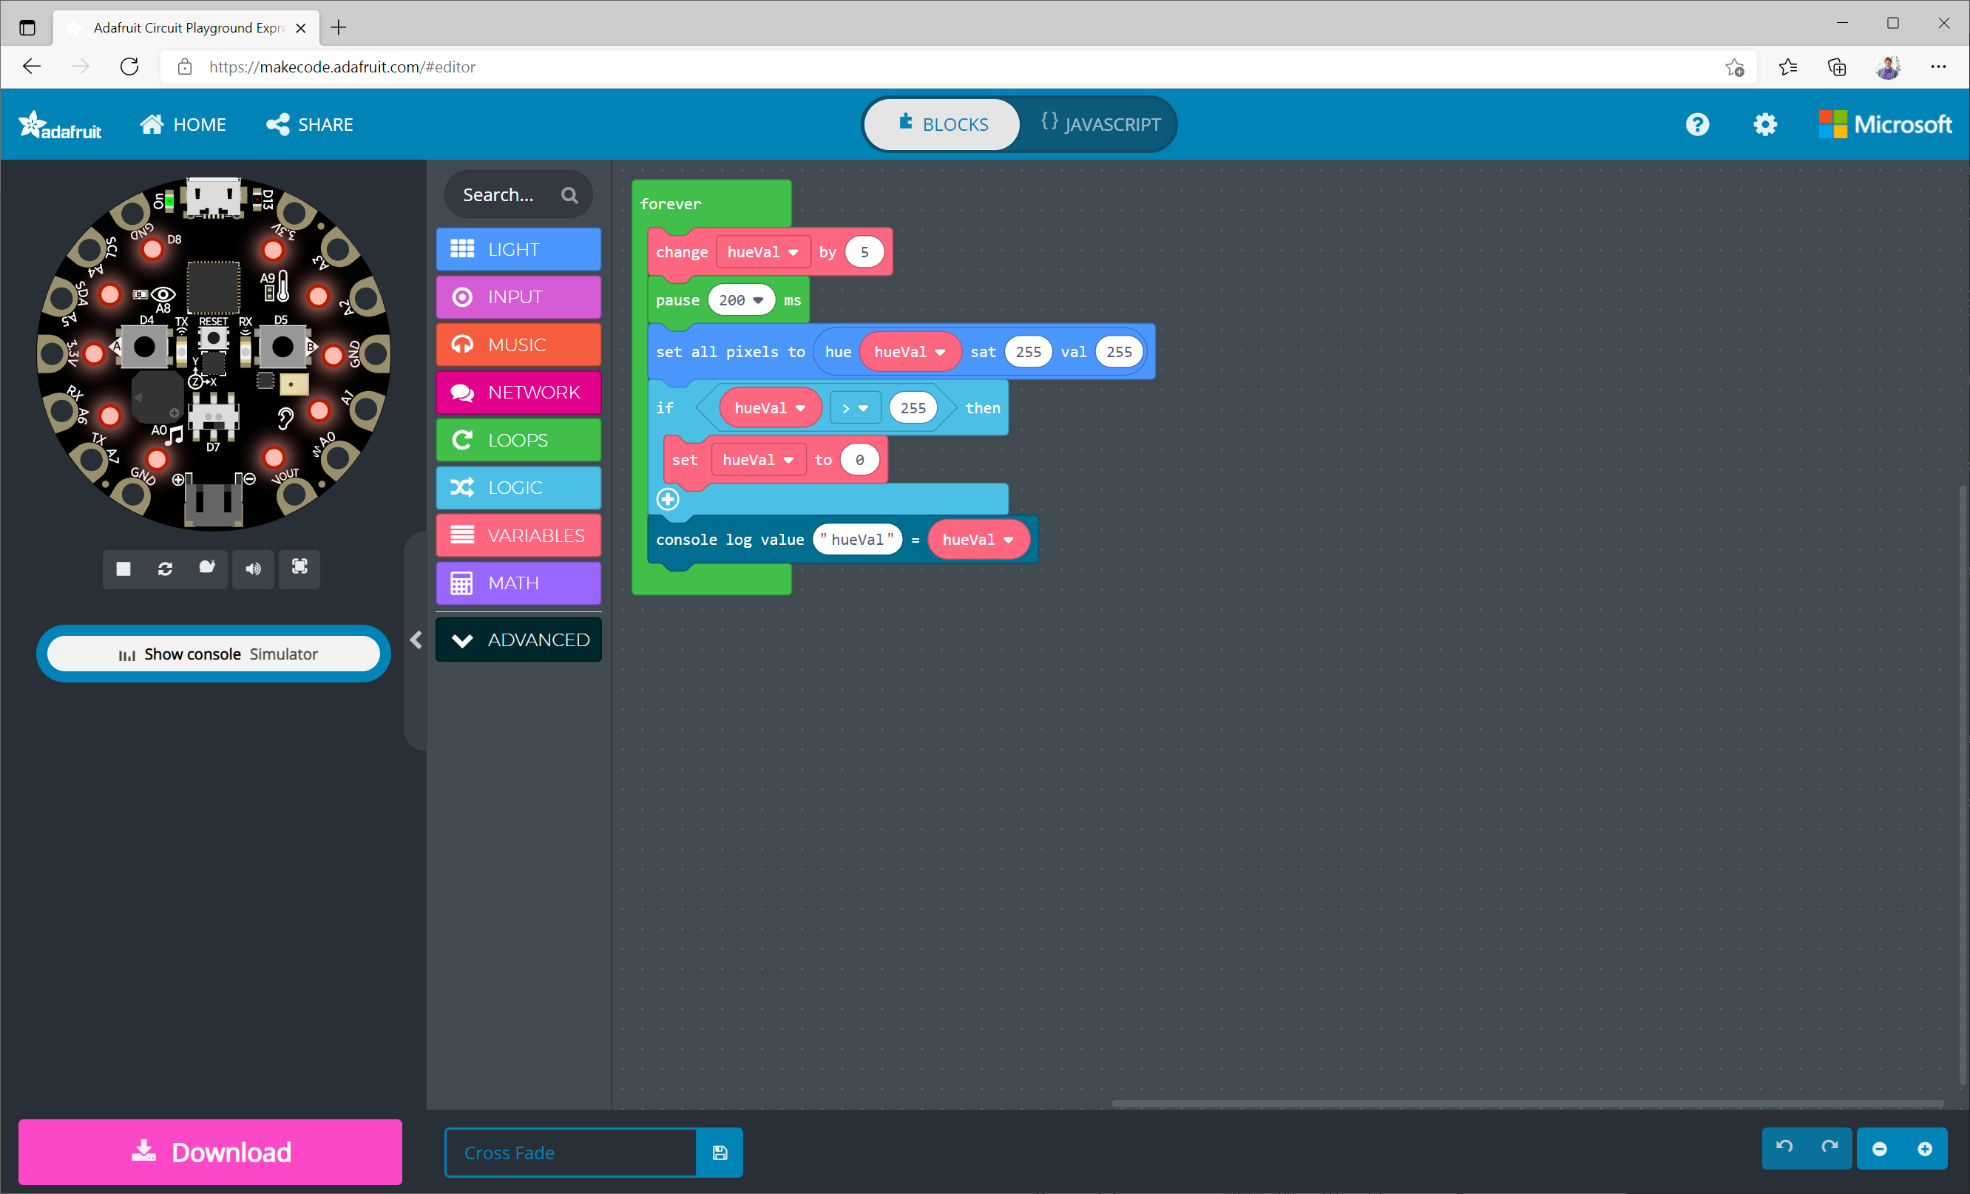
Notes:
https://makecode.com/_FKs1bjWDD8ph

Slide 13
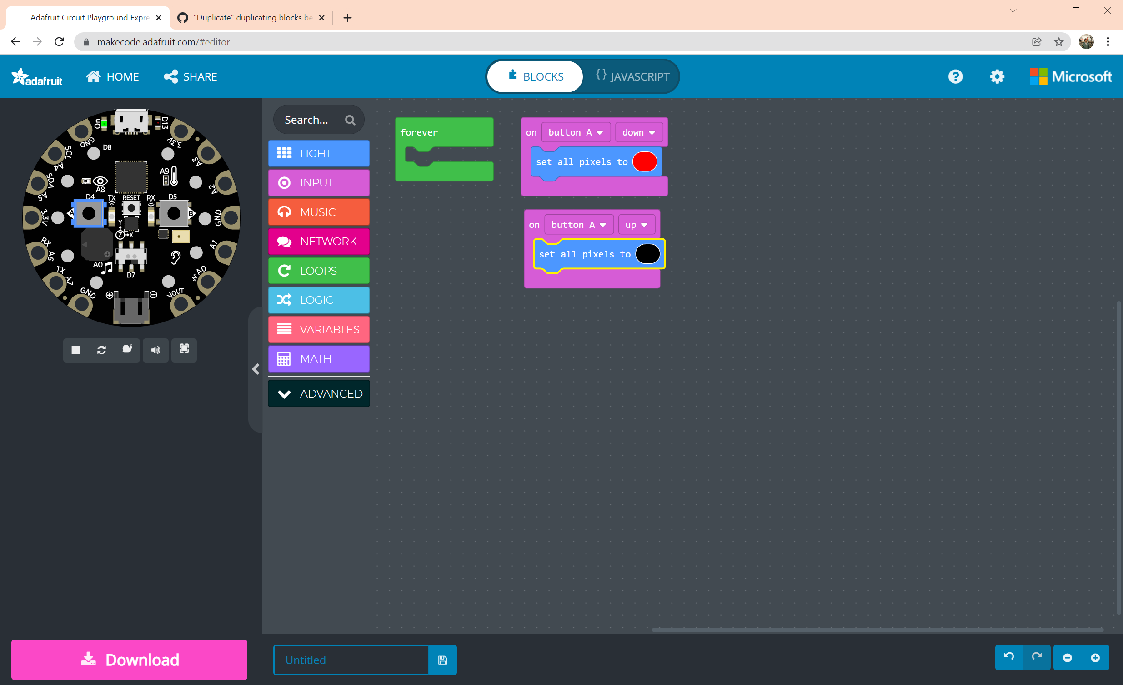
Notes:
input.buttonA.onEvent(ButtonEvent.Down, function () {
light.setAll(0xff0000)
})
input.buttonA.onEvent(ButtonEvent.Up, function () {
light.setAll(0x000000)
})
forever(function () {
})

Slide 14
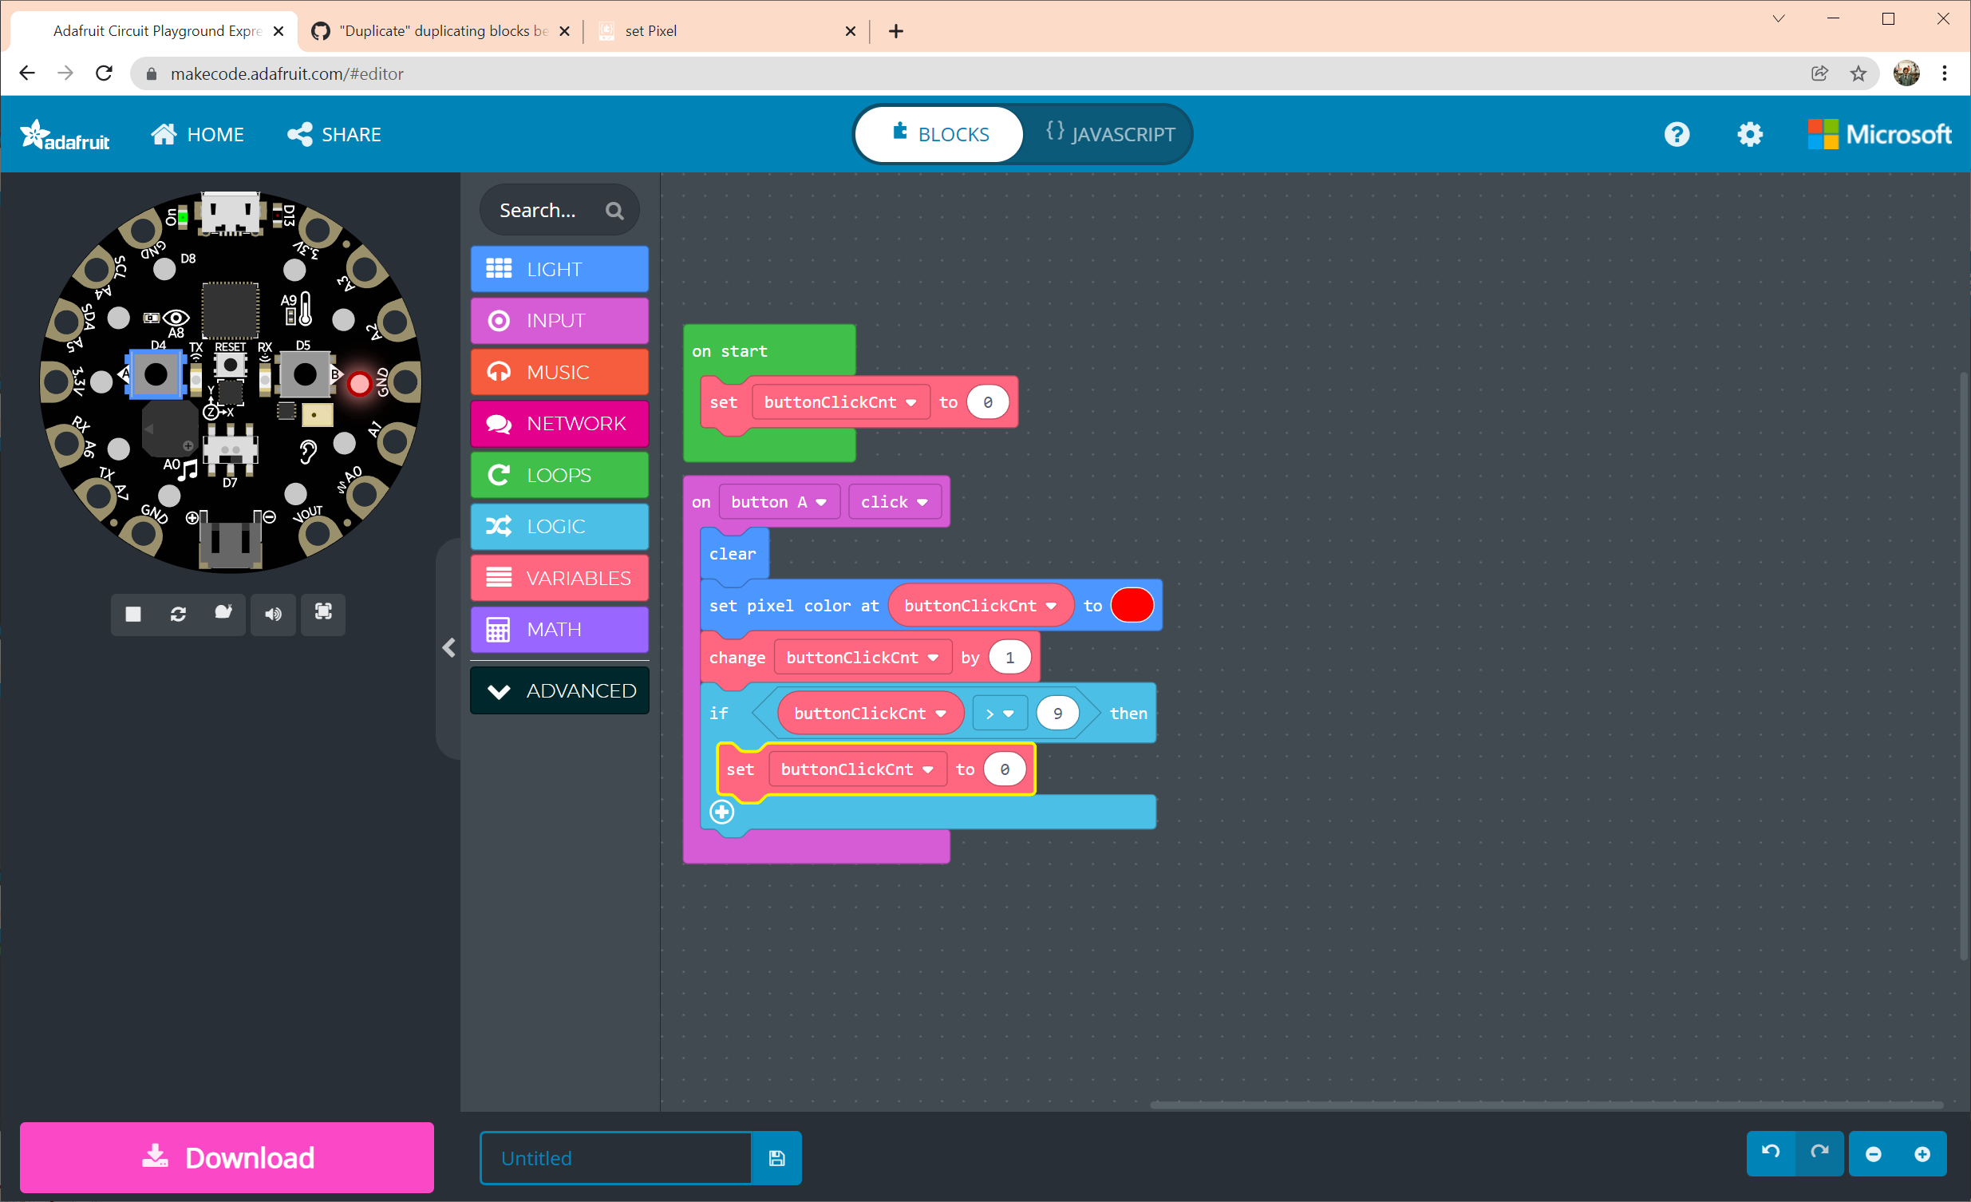
Notes:
input.buttonA.onEvent(ButtonEvent.Click, function () {
light.clear()
light.setPixelColor(buttonClickCnt, 0xff0000)
buttonClickCnt += 1
if (buttonClickCnt > 9) {
buttonClickCnt = 0
}
})
let buttonClickCnt = 0
buttonClickCnt = 0

Slide 15
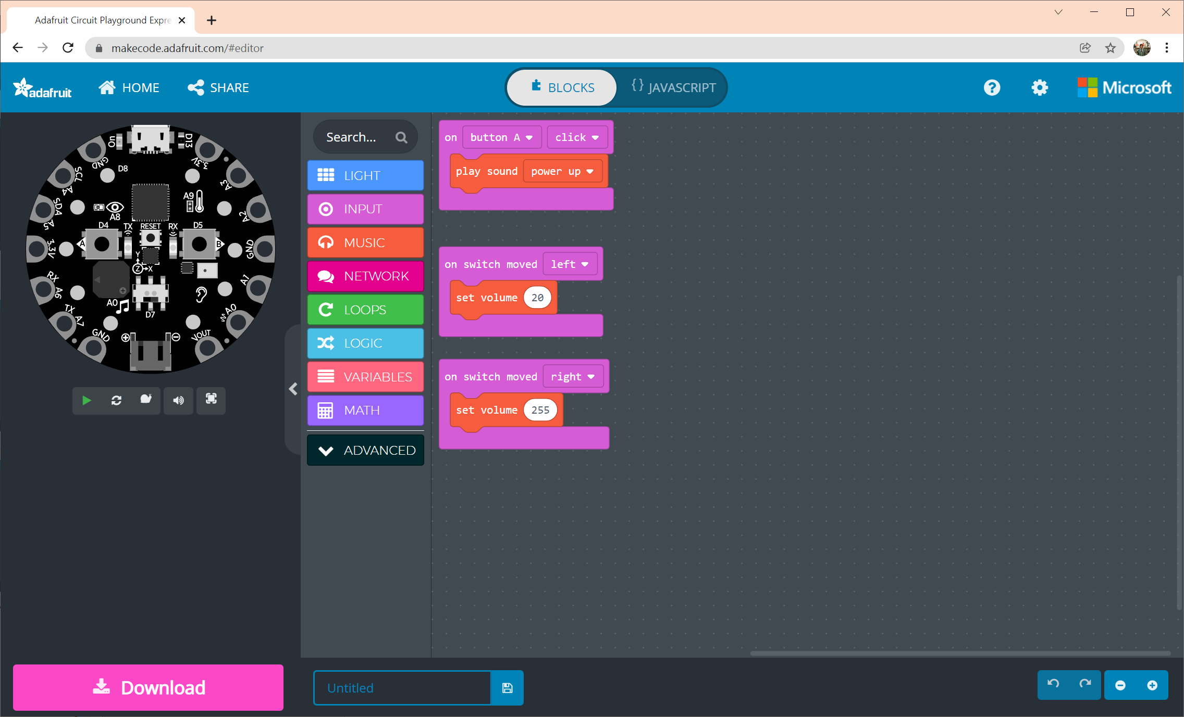
Notes:
input.buttonA.onEvent(ButtonEvent.Click, function () {
music.powerUp.play()
})
input.onSwitchMoved(SwitchDirection.Left, function () {
music.setVolume(20)
})
input.onSwitchMoved(SwitchDirection.Right, function () {
music.setVolume(255)
})

Slide 16
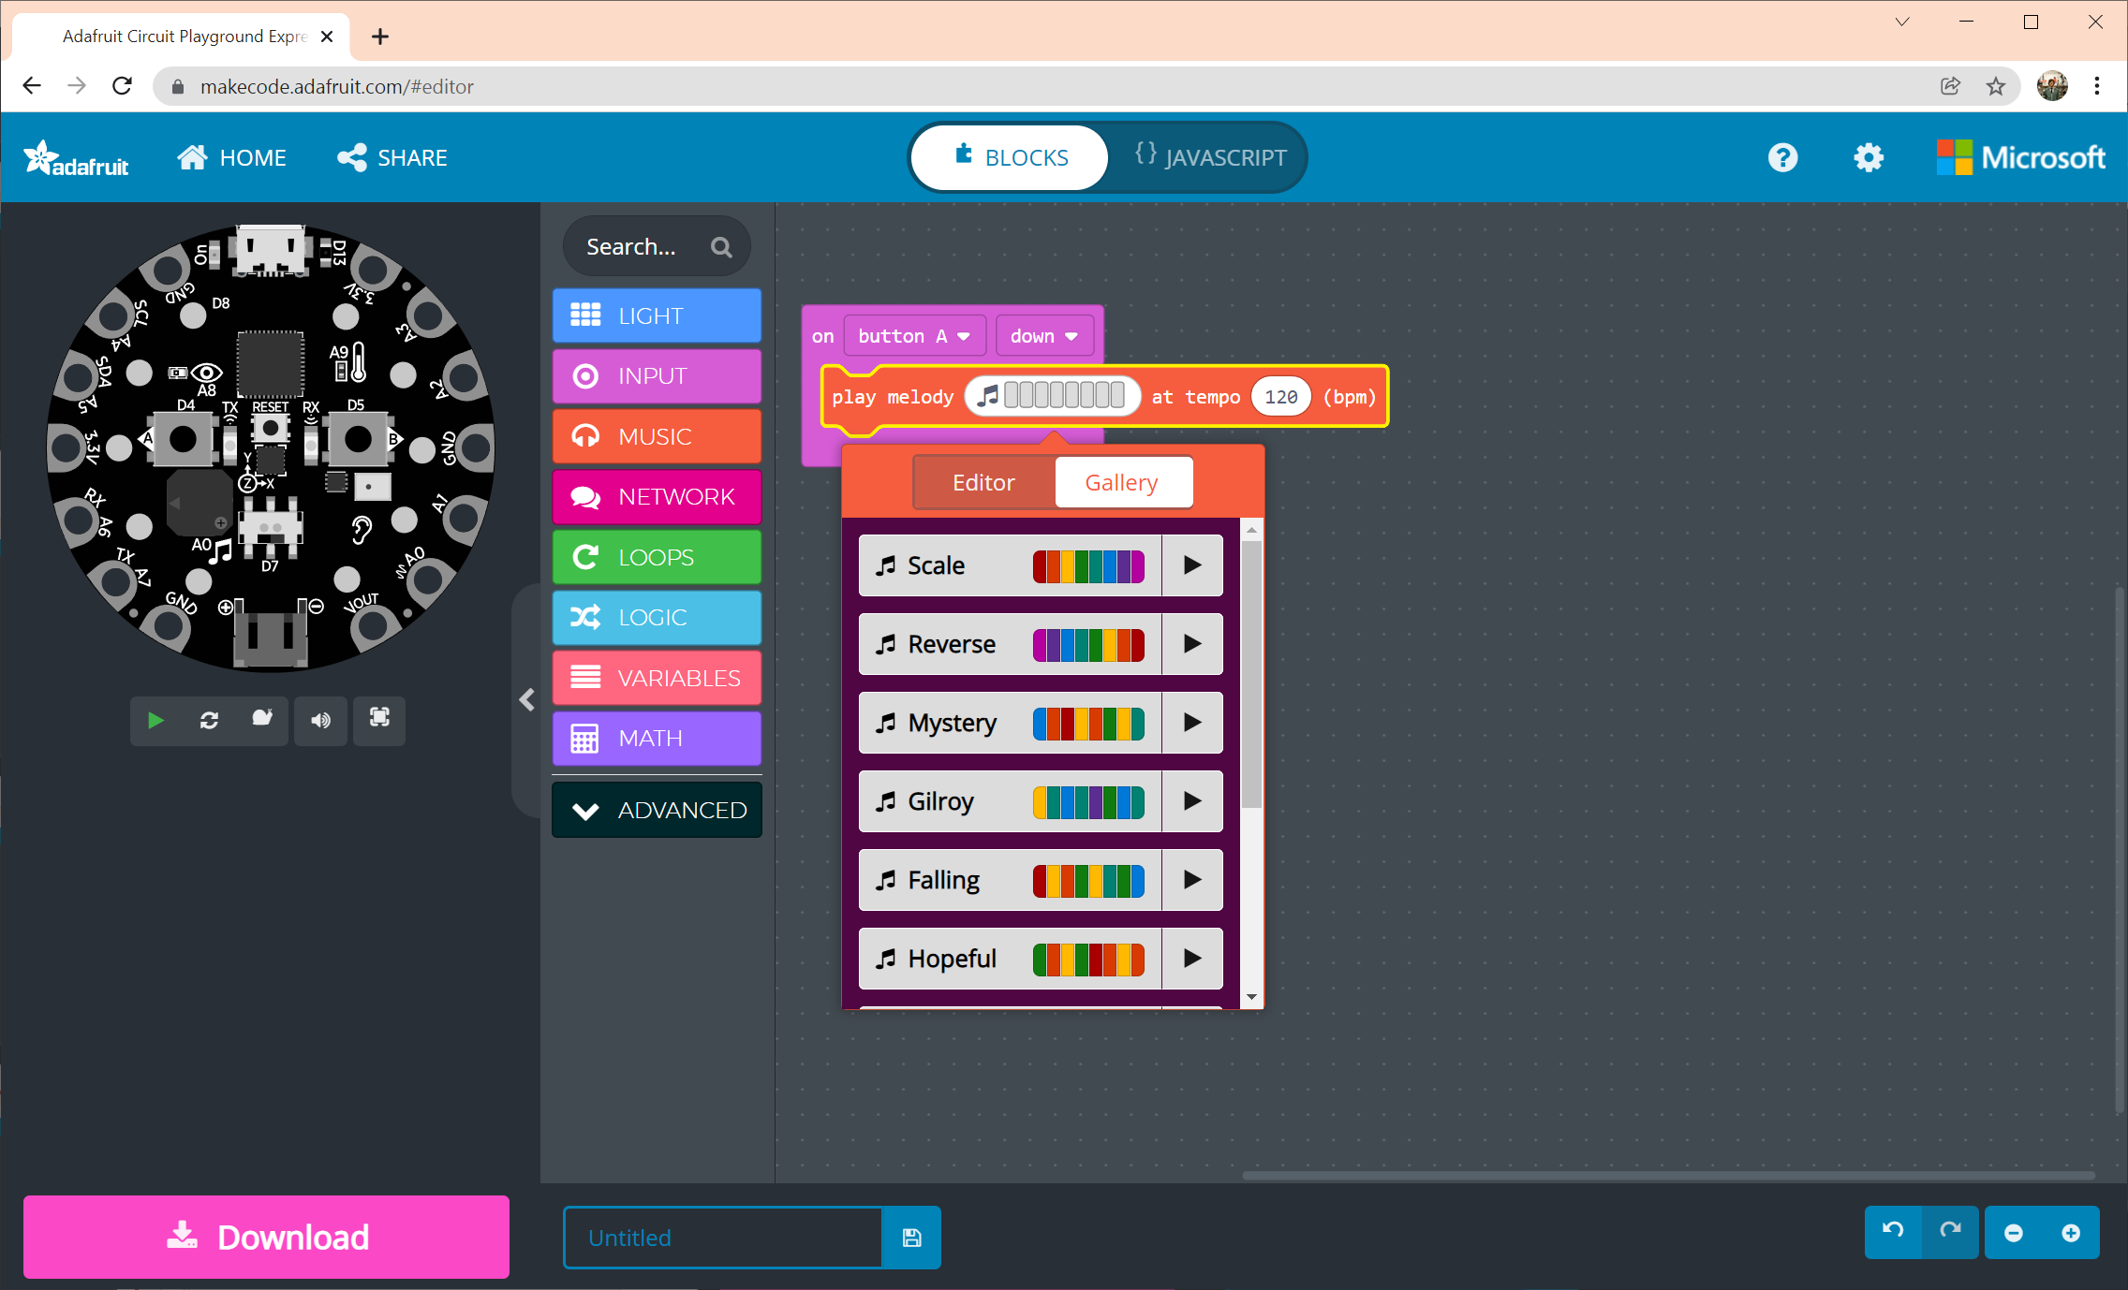

Slide 17
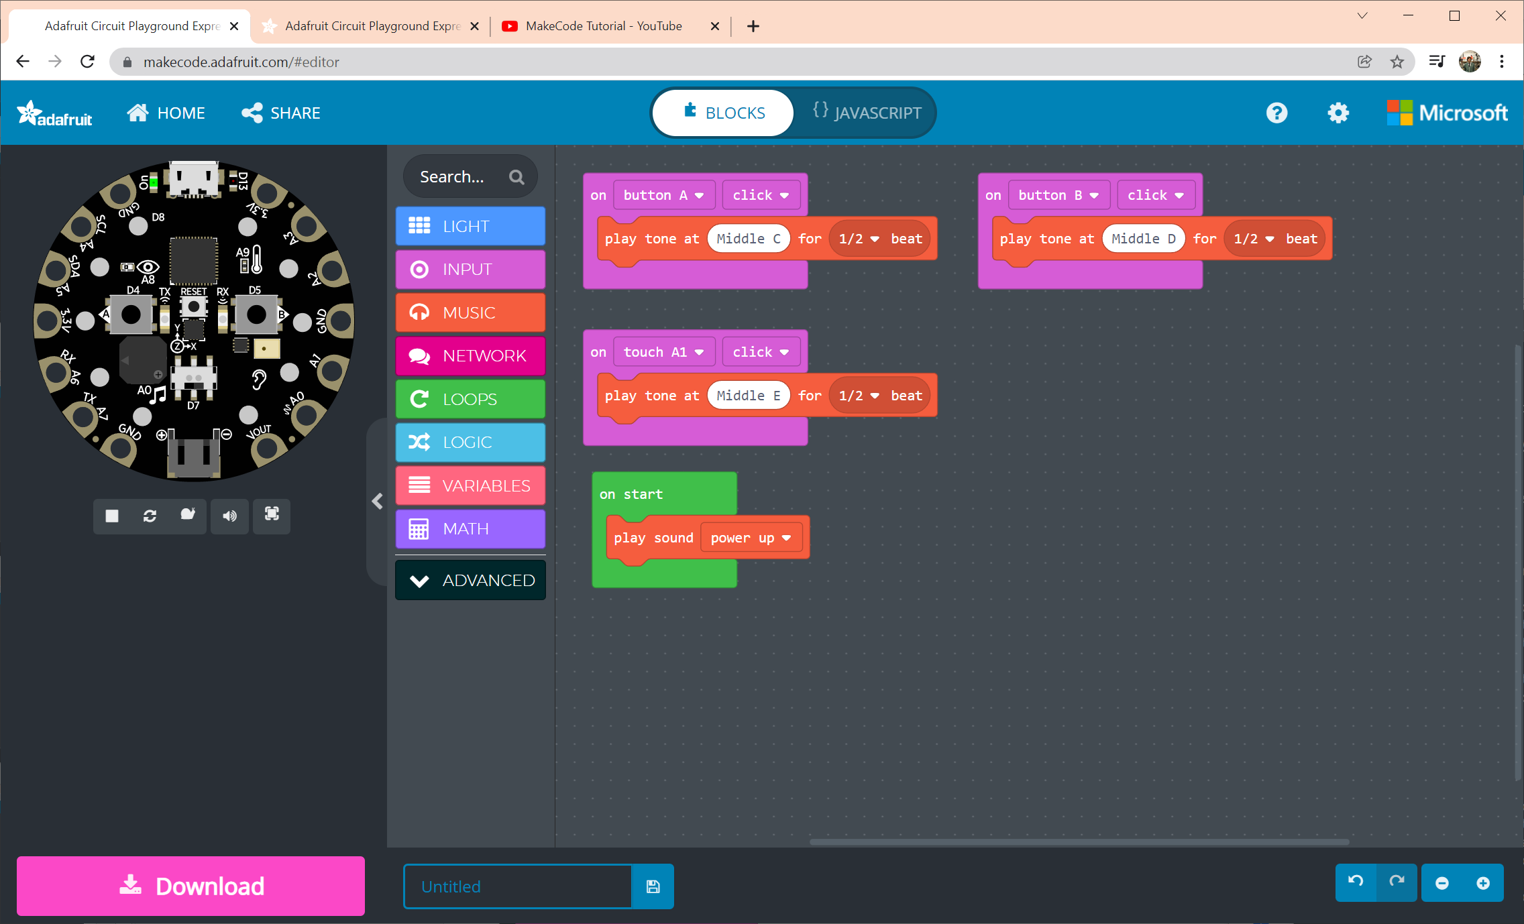

Slide 18
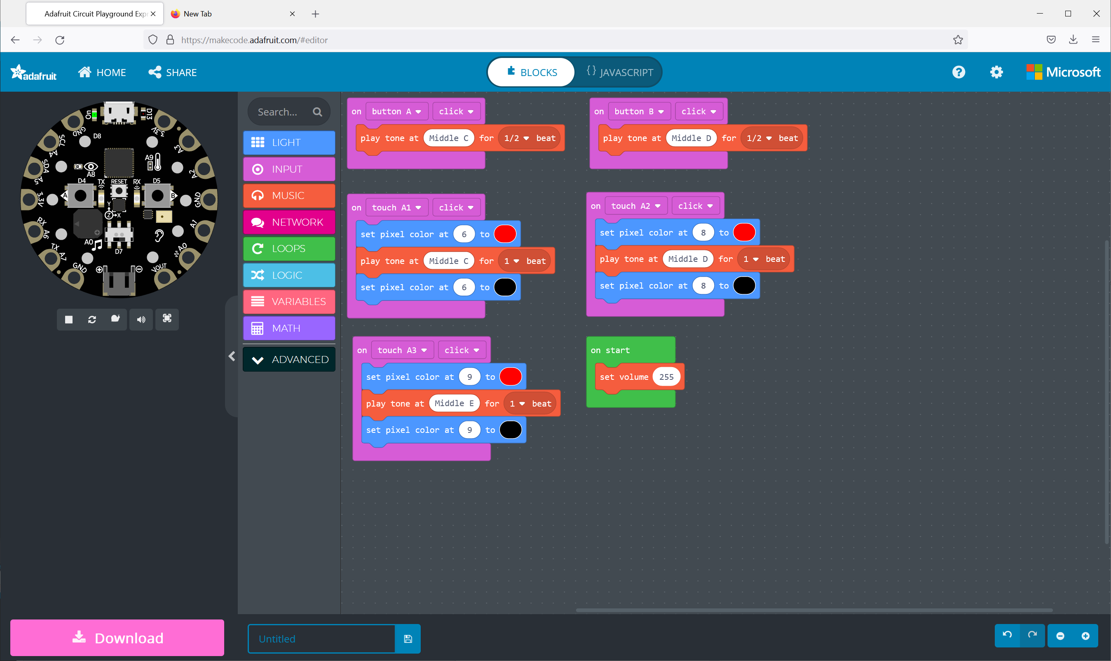
Notes:
input.buttonA.onEvent(ButtonEvent.Click, function () {
music.playTone(262, music.beat(BeatFraction.Half))
})
input.buttonB.onEvent(ButtonEvent.Click, function () {
music.playTone(294, music.beat(BeatFraction.Half))
})
input.touchA1.onEvent(ButtonEvent.Click, function () {
light.setPixelColor(6, 0xff0000)
music.playTone(262, music.beat(BeatFraction.Whole))
light.setPixelColor(6, 0x000000)
})
input.touchA2.onEvent(ButtonEvent.Click, function () {
light.setPixelColor(8, 0xff0000)
music.playTone(294, music.beat(BeatFraction.Whole))
light.setPixelColor(8, 0x000000)
})
input.touchA3.onEvent(ButtonEvent.Click, function () {
light.setPixelColor(9, 0xff0000)
music.playTone(330, music.beat(BeatFraction.Whole))
light.setPixelColor(9, 0x000000)
})
music.setVolume(255)

Slide 19
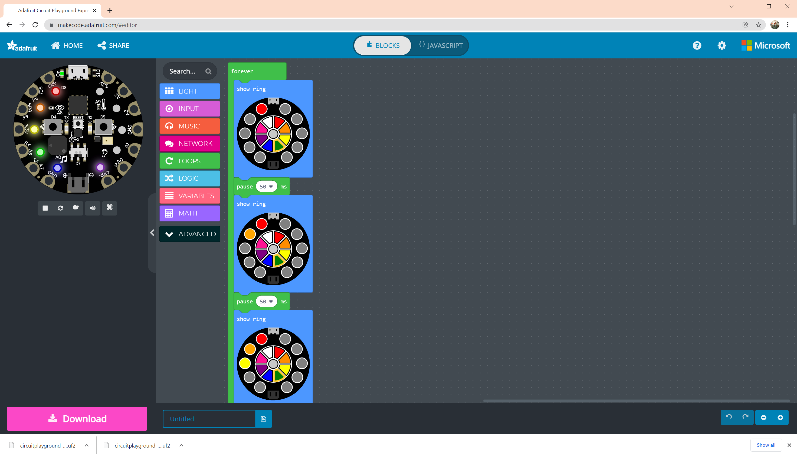
Notes:
Loop light (to mimic opening system)
----
forever(function () {
light.showRing(
`red black black black black black black black black black`
)
pause(50)
light.showRing(
`red orange black black black black black black black black`
)
pause(50)
light.showRing(
`red orange yellow black black black black black black black`
)
pause(50)
light.showRing(
`red orange yellow green black black black black black black`
)
pause(50)
light.showRing(
`red orange yellow green blue black black black black black`
)
pause(50)
light.showRing(
`red orange yellow green blue purple black black black black`
)
})

Slide 20
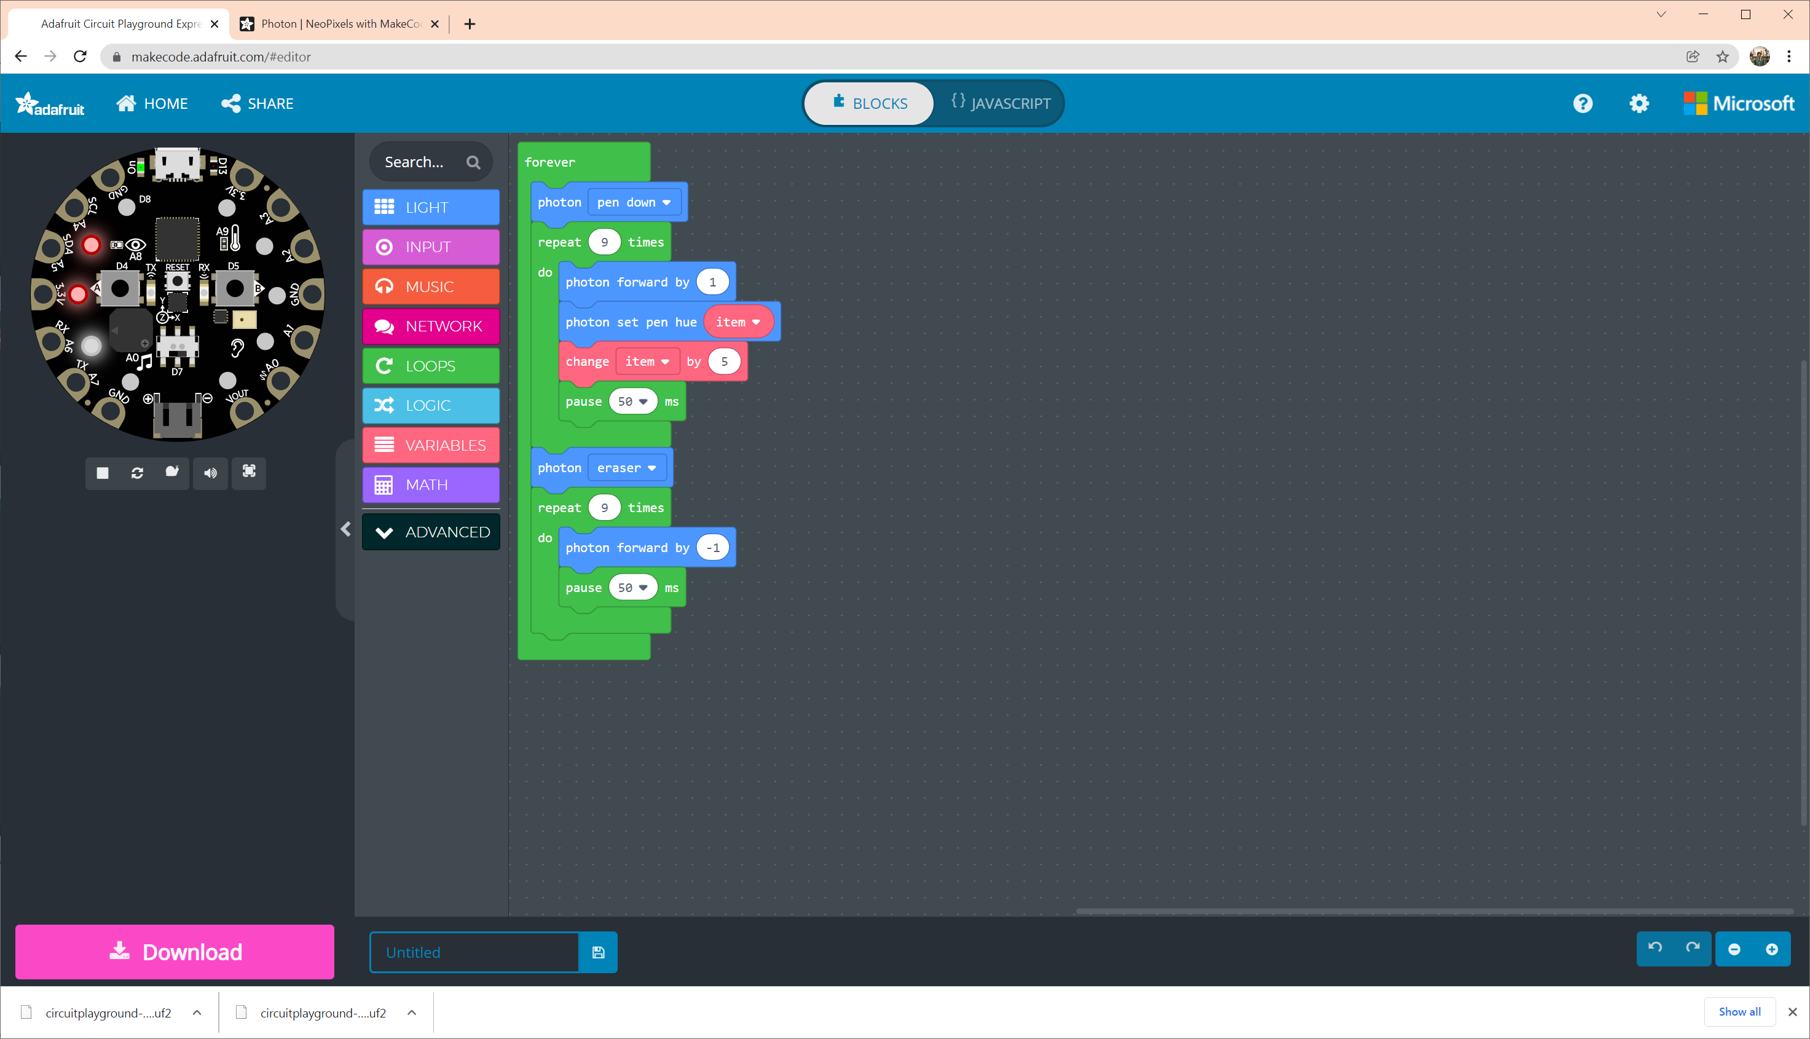
Notes:
https://learn.adafruit.com/neopixels-with-makecode/photon

Slide 21
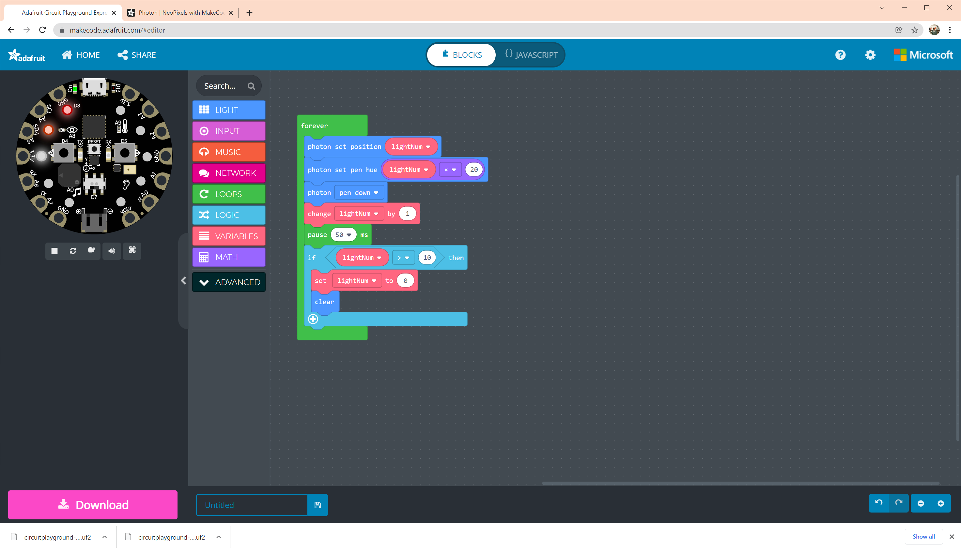
Notes:
Trying to copy the opening animation
----
let lightNum = 0
forever(function () {
light.setPhotonPosition(lightNum)
light.setPhotonPenHue(lightNum * 20)
light.setPhotonMode(PhotonMode.PenDown)
lightNum += 1
pause(50)
if (lightNum > 10) {
lightNum = 0
light.clear()
}
})

Slide 22
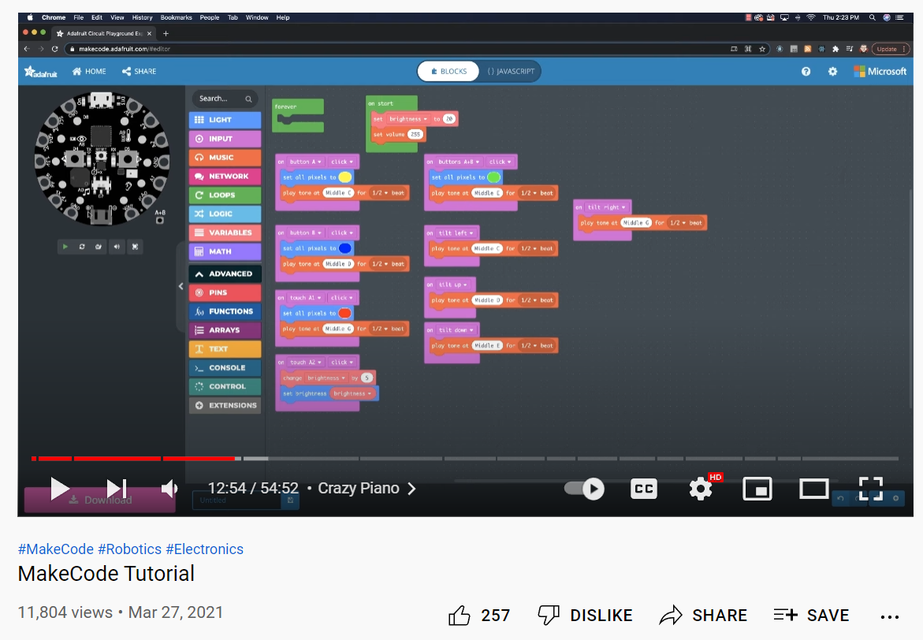
Notes:
https://youtu.be/NIKu0-Tgh2M?t=774

Slide 23
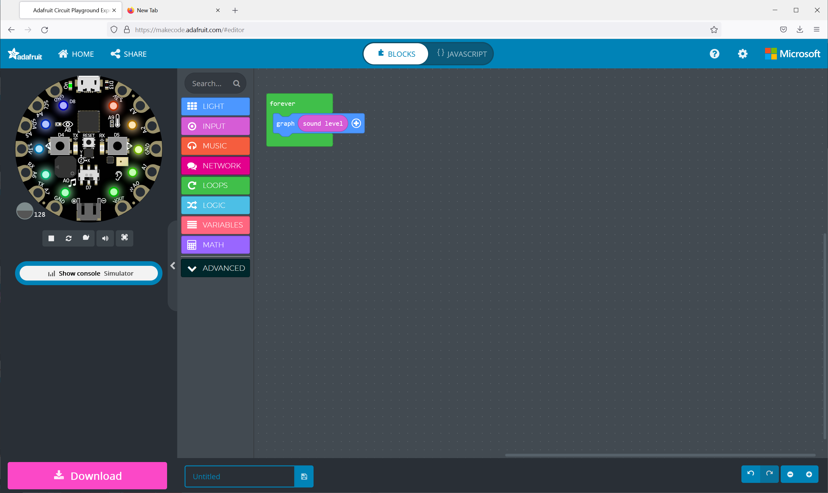
Sound meter
Notes:
Sound meter
---
forever(function () {
light.graph(input.soundLevel(), 255)
})

Slide 24
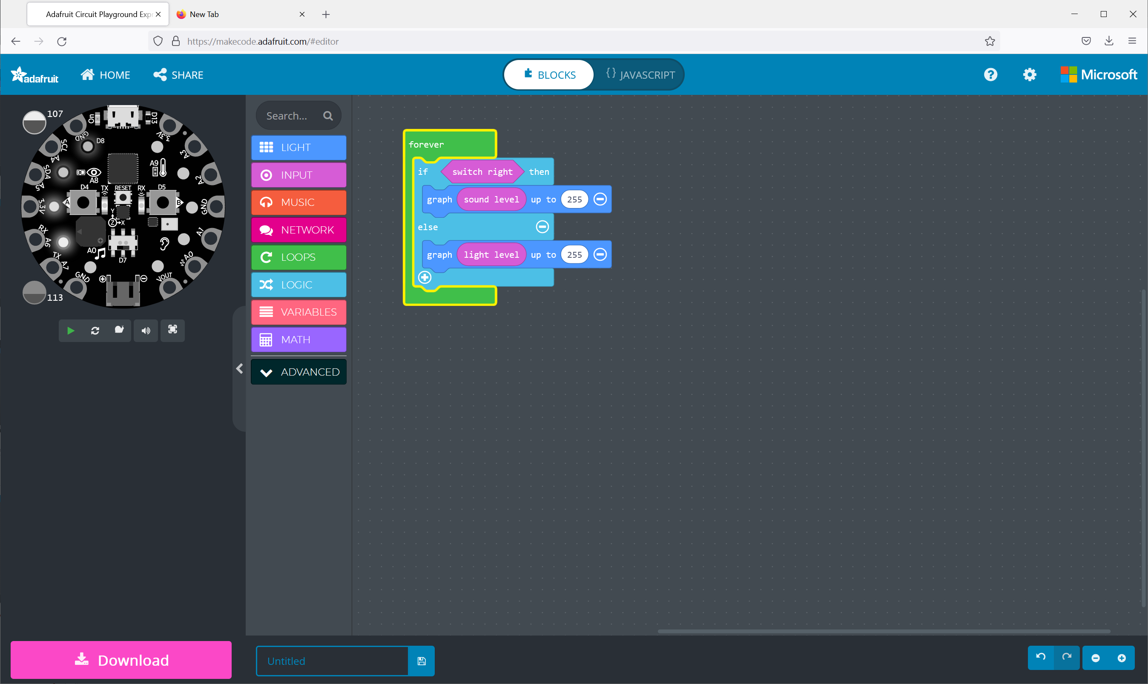
Notes:
Sound and light meter depending on switch position

Slide 25
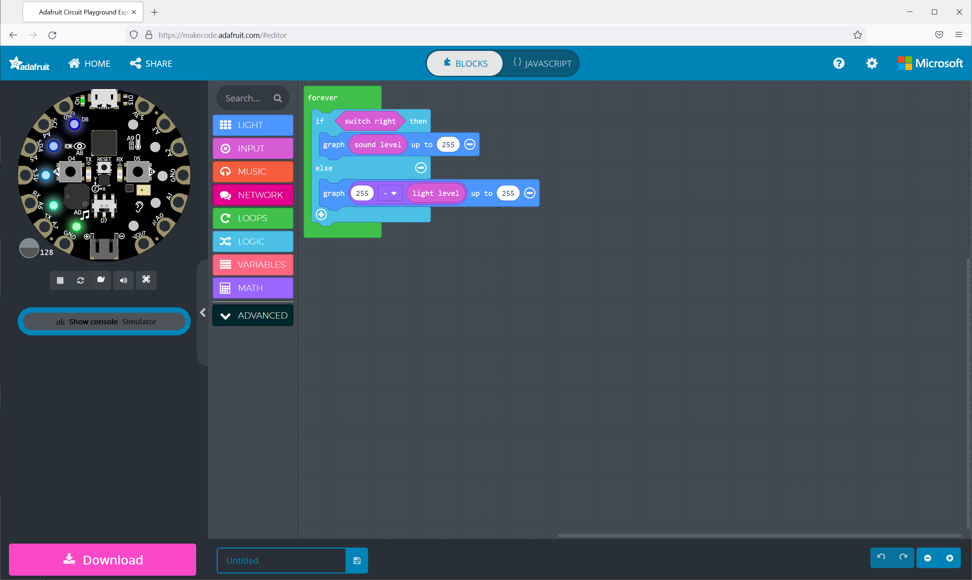
Notes:
Nite light
---
forever(function () {
if (input.switchRight()) {
light.graph(input.soundLevel(), 255)
} else {
light.graph(255 - input.lightLevel(), 255)
}
})

Slide 26
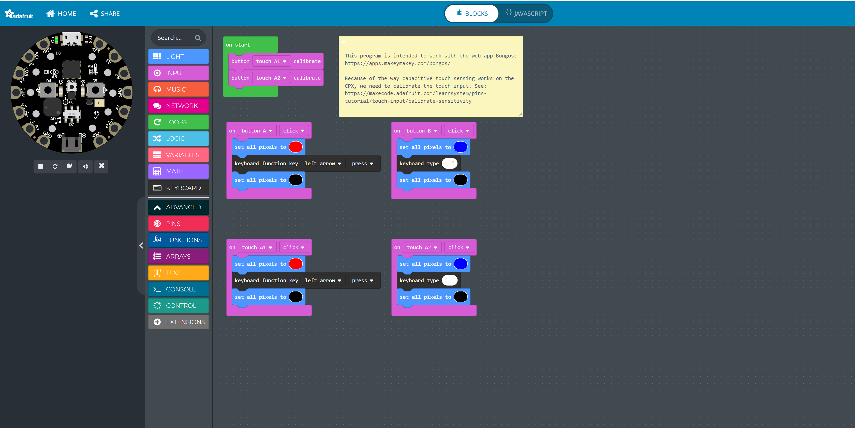
Notes:
https://makecode.com/_RpCTDH73vEJj
---
/**
* This program is intended to work with the web app Bongos:
*
* https://apps.makeymakey.com/bongos/
*
* Because of the way capacitive touch sensing works on the CPX, we need to calibrate the touch input. See: https://makecode.adafruit.com/learnsystem/pins-tutorial/touch-input/calibrate-sensitivity
*
* ---
*
* Jon E. Froehlich
*
* https://jonfroehlich.github.io/
*/
input.buttonA.onEvent(ButtonEvent.Click, function () {
light.setAll(0xff0000)
keyboard.functionKey(KeyboardFunctionKey.LeftArrow, KeyboardKeyEvent.Press)
light.setAll(0x000000)
})
input.buttonB.onEvent(ButtonEvent.Click, function () {
light.setAll(0x0000ff)
keyboard.type(" ")
light.setAll(0x000000)
})
input.touchA1.onEvent(ButtonEvent.Click, function () {
light.setAll(0xff0000)
keyboard.functionKey(KeyboardFunctionKey.LeftArrow, KeyboardKeyEvent.Press)
light.setAll(0x000000)
})
input.touchA2.onEvent(ButtonEvent.Click, function () {
light.setAll(0x0000ff)
keyboard.type(" ")
light.setAll(0x000000)
})
input.touchA1.calibrate()
input.touchA2.calibrate()

Slide 27
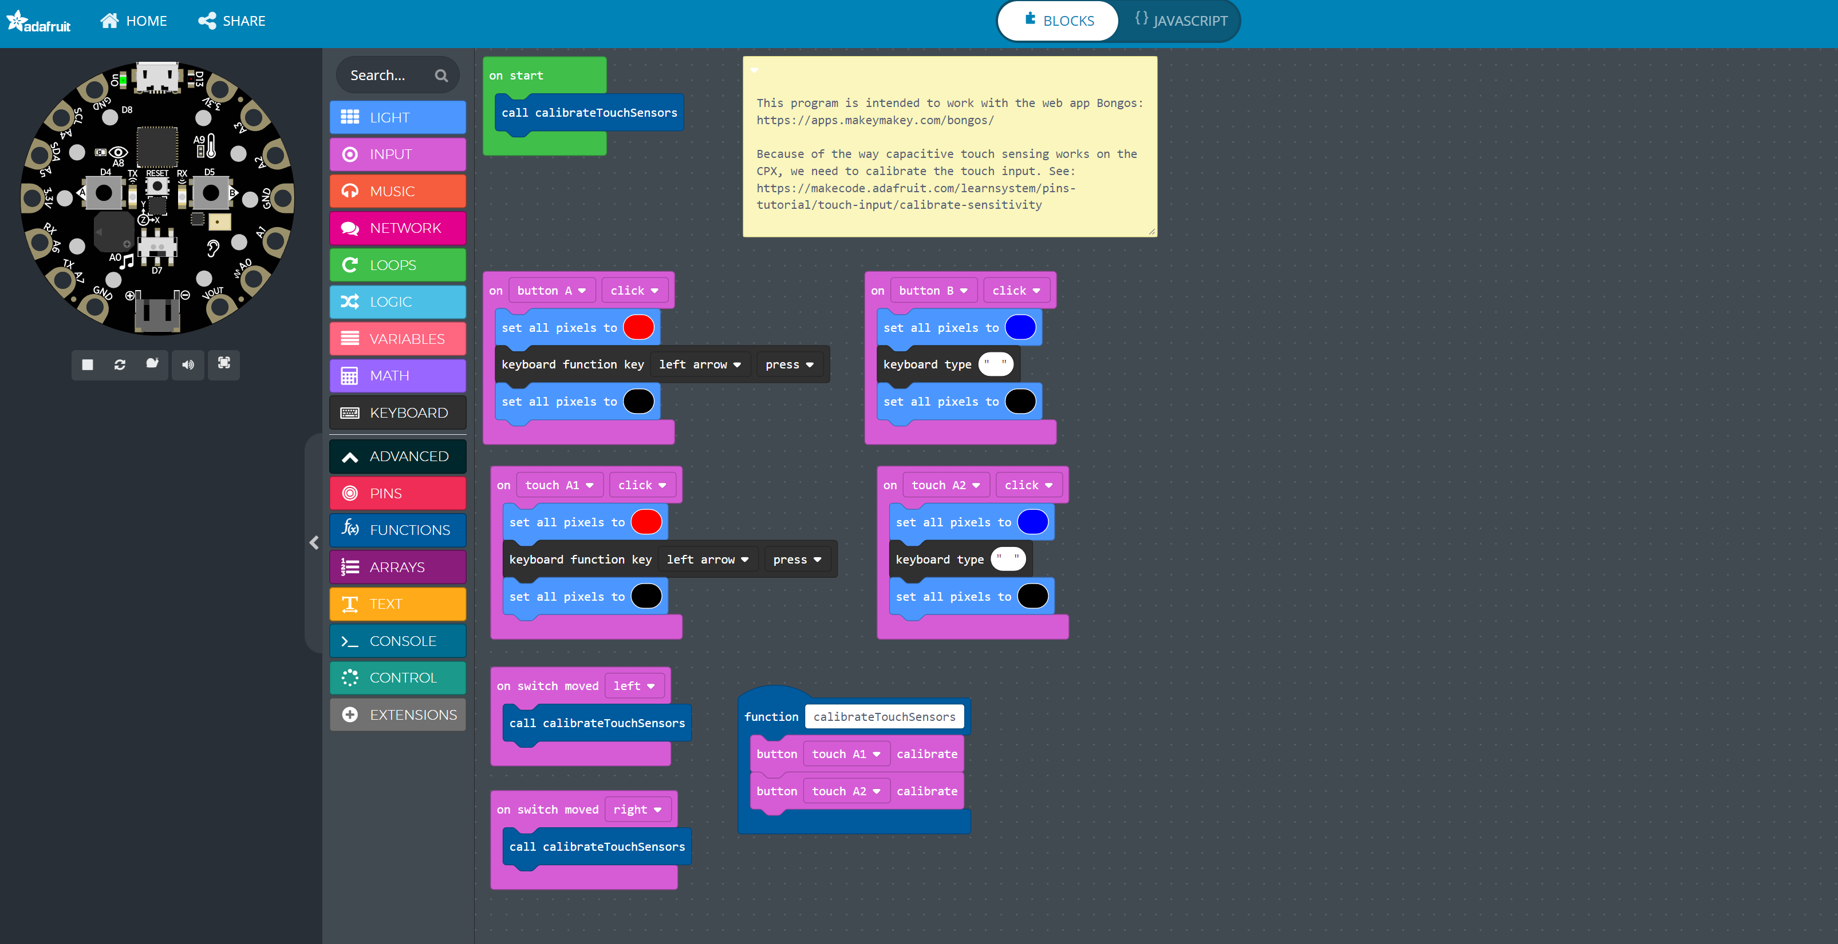
Notes:
https://makecode.com/_VyXMTMeE26tp
---
/**
* This program is intended to work with the web app Bongos:
*
* https://apps.makeymakey.com/bongos/
*
* Because of the way capacitive touch sensing works on the CPX, we need to calibrate the touch input. See: https://makecode.adafruit.com/learnsystem/pins-tutorial/touch-input/calibrate-sensitivity
*
* ---
*
* Jon E. Froehlich
*
* https://jonfroehlich.github.io/
*/
input.buttonA.onEvent(ButtonEvent.Click, function () {
light.setAll(0xff0000)
keyboard.functionKey(KeyboardFunctionKey.LeftArrow, KeyboardKeyEvent.Press)
light.setAll(0x000000)
})
input.buttonB.onEvent(ButtonEvent.Click, function () {
light.setAll(0x0000ff)
keyboard.type(" ")
light.setAll(0x000000)
})
input.touchA1.onEvent(ButtonEvent.Click, function () {
light.setAll(0xff0000)
keyboard.functionKey(KeyboardFunctionKey.LeftArrow, KeyboardKeyEvent.Press)
light.setAll(0x000000)
})
input.touchA2.onEvent(ButtonEvent.Click, function () {
light.setAll(0x0000ff)
keyboard.type(" ")
light.setAll(0x000000)
})
input.onSwitchMoved(SwitchDirection.Left, function () {
calibrateTouchSensors()
})
function calibrateTouchSensors () {
input.touchA1.calibrate()
input.touchA2.calibrate()
}
input.onSwitchMoved(SwitchDirection.Right, function () {
calibrateTouchSensors()
})
calibrateTouchSensors()

Slide 28
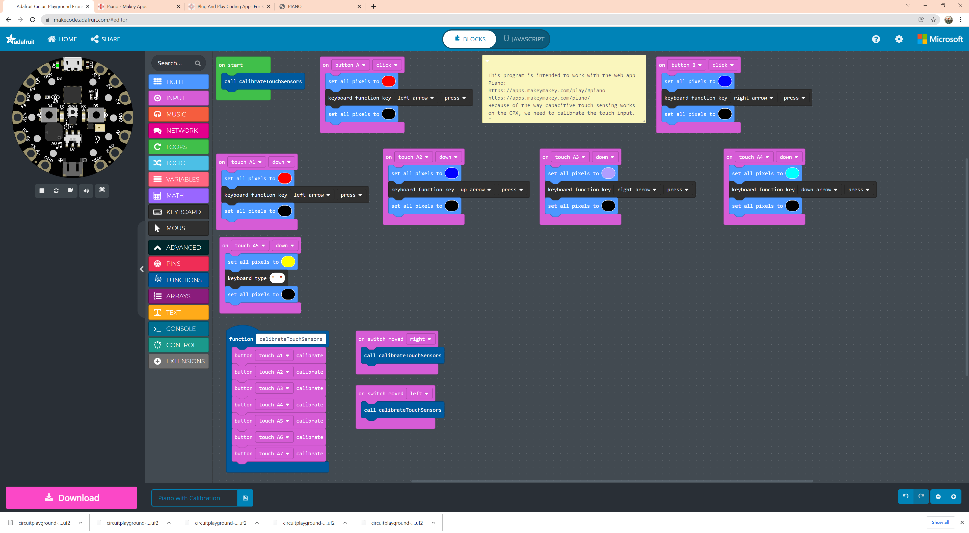
Notes:
https://makecode.com/_FMXHKYhRJALU

Slide 29
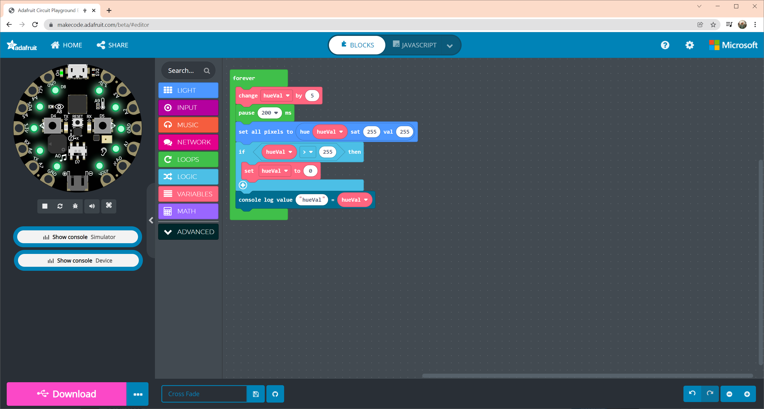

Slide 30
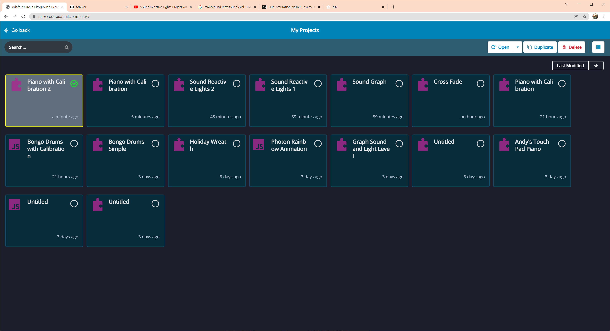

Slide 31
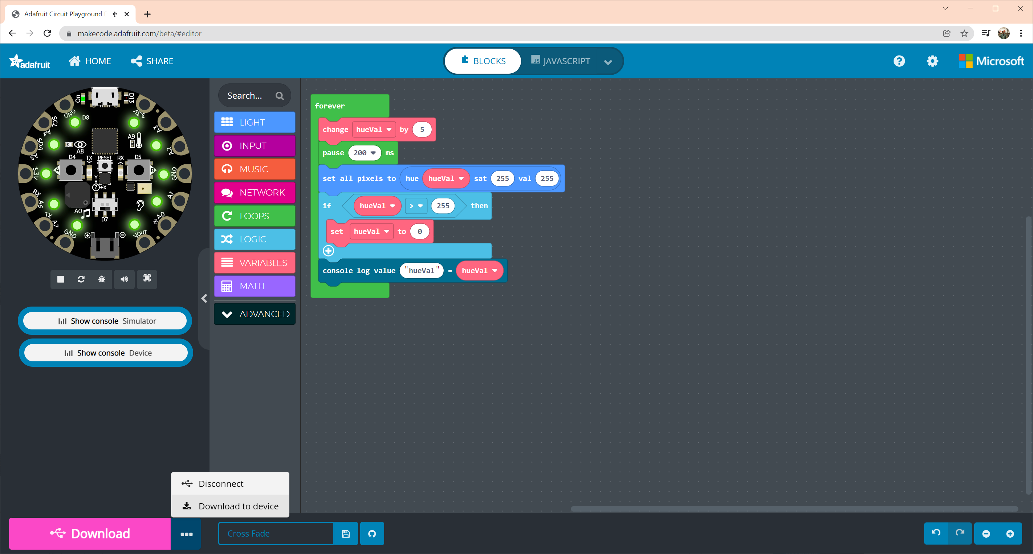

Slide 32
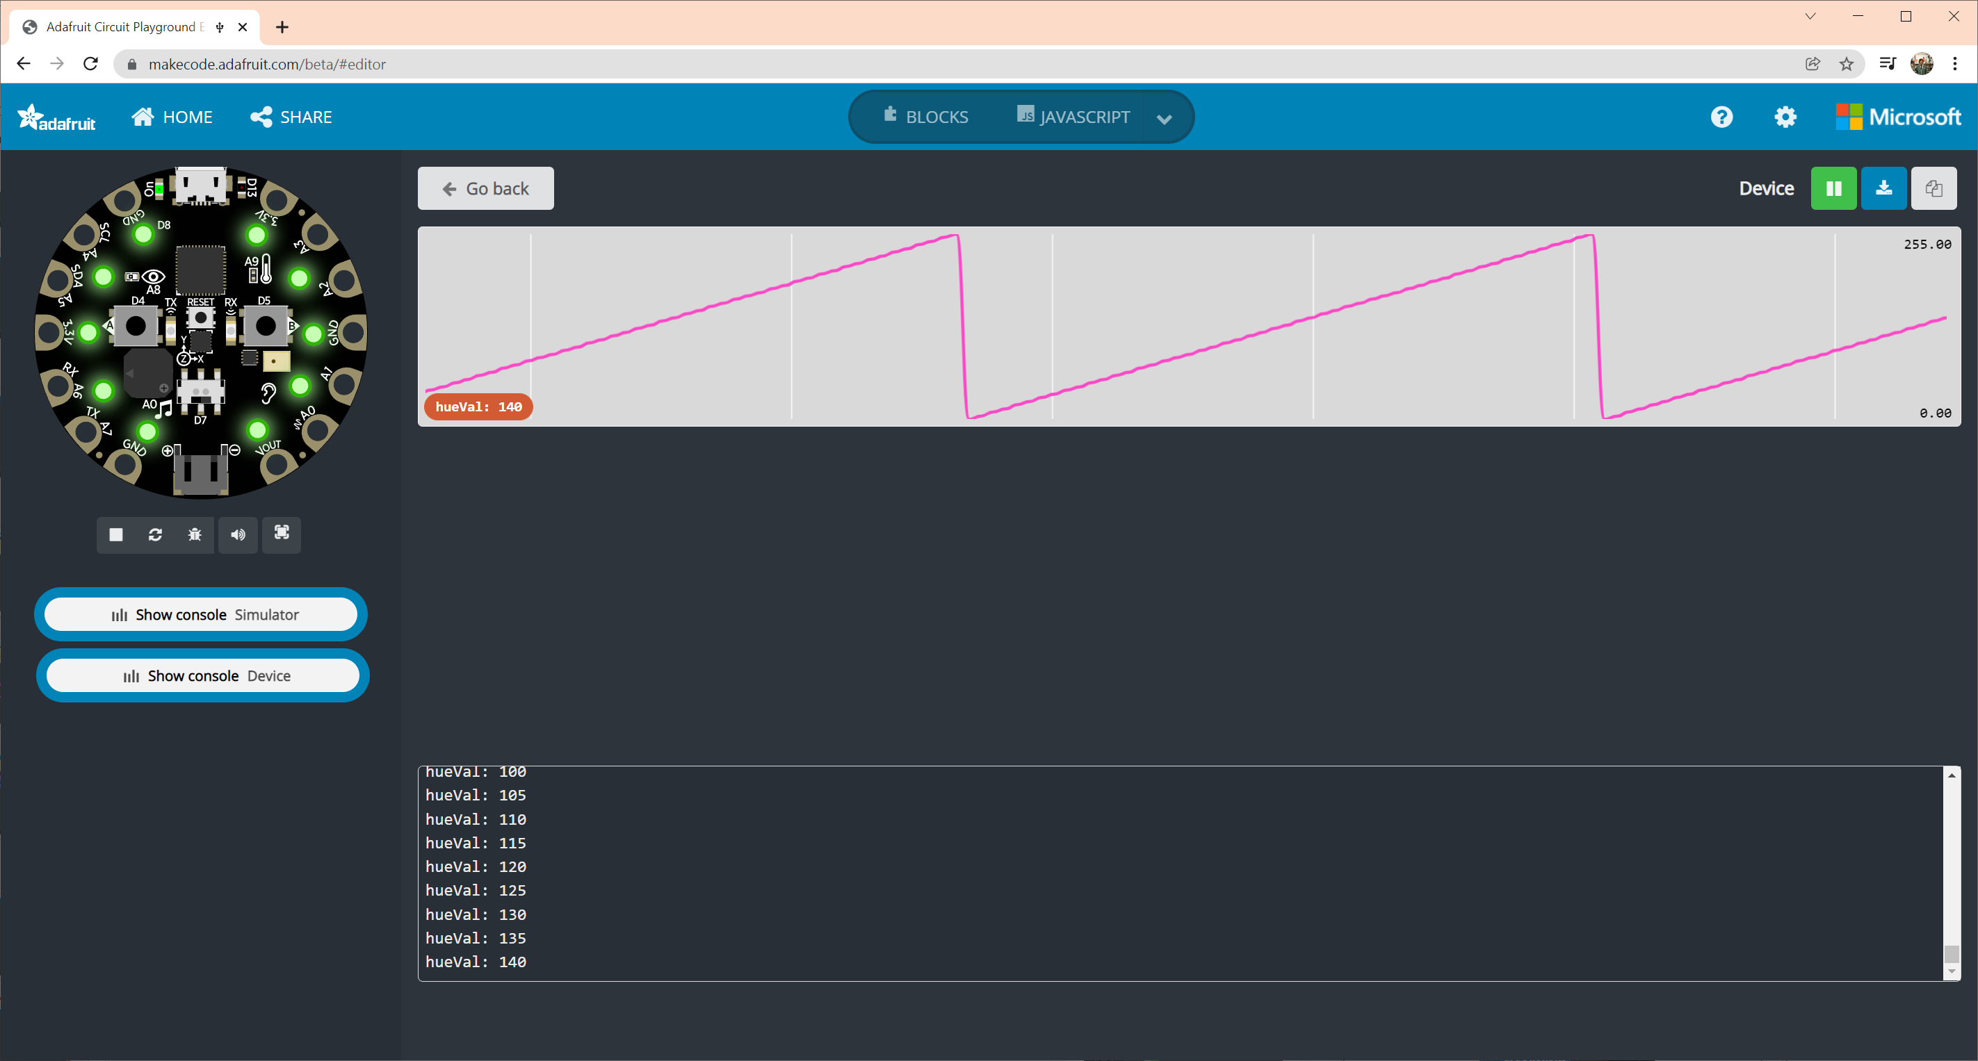

Slide 33
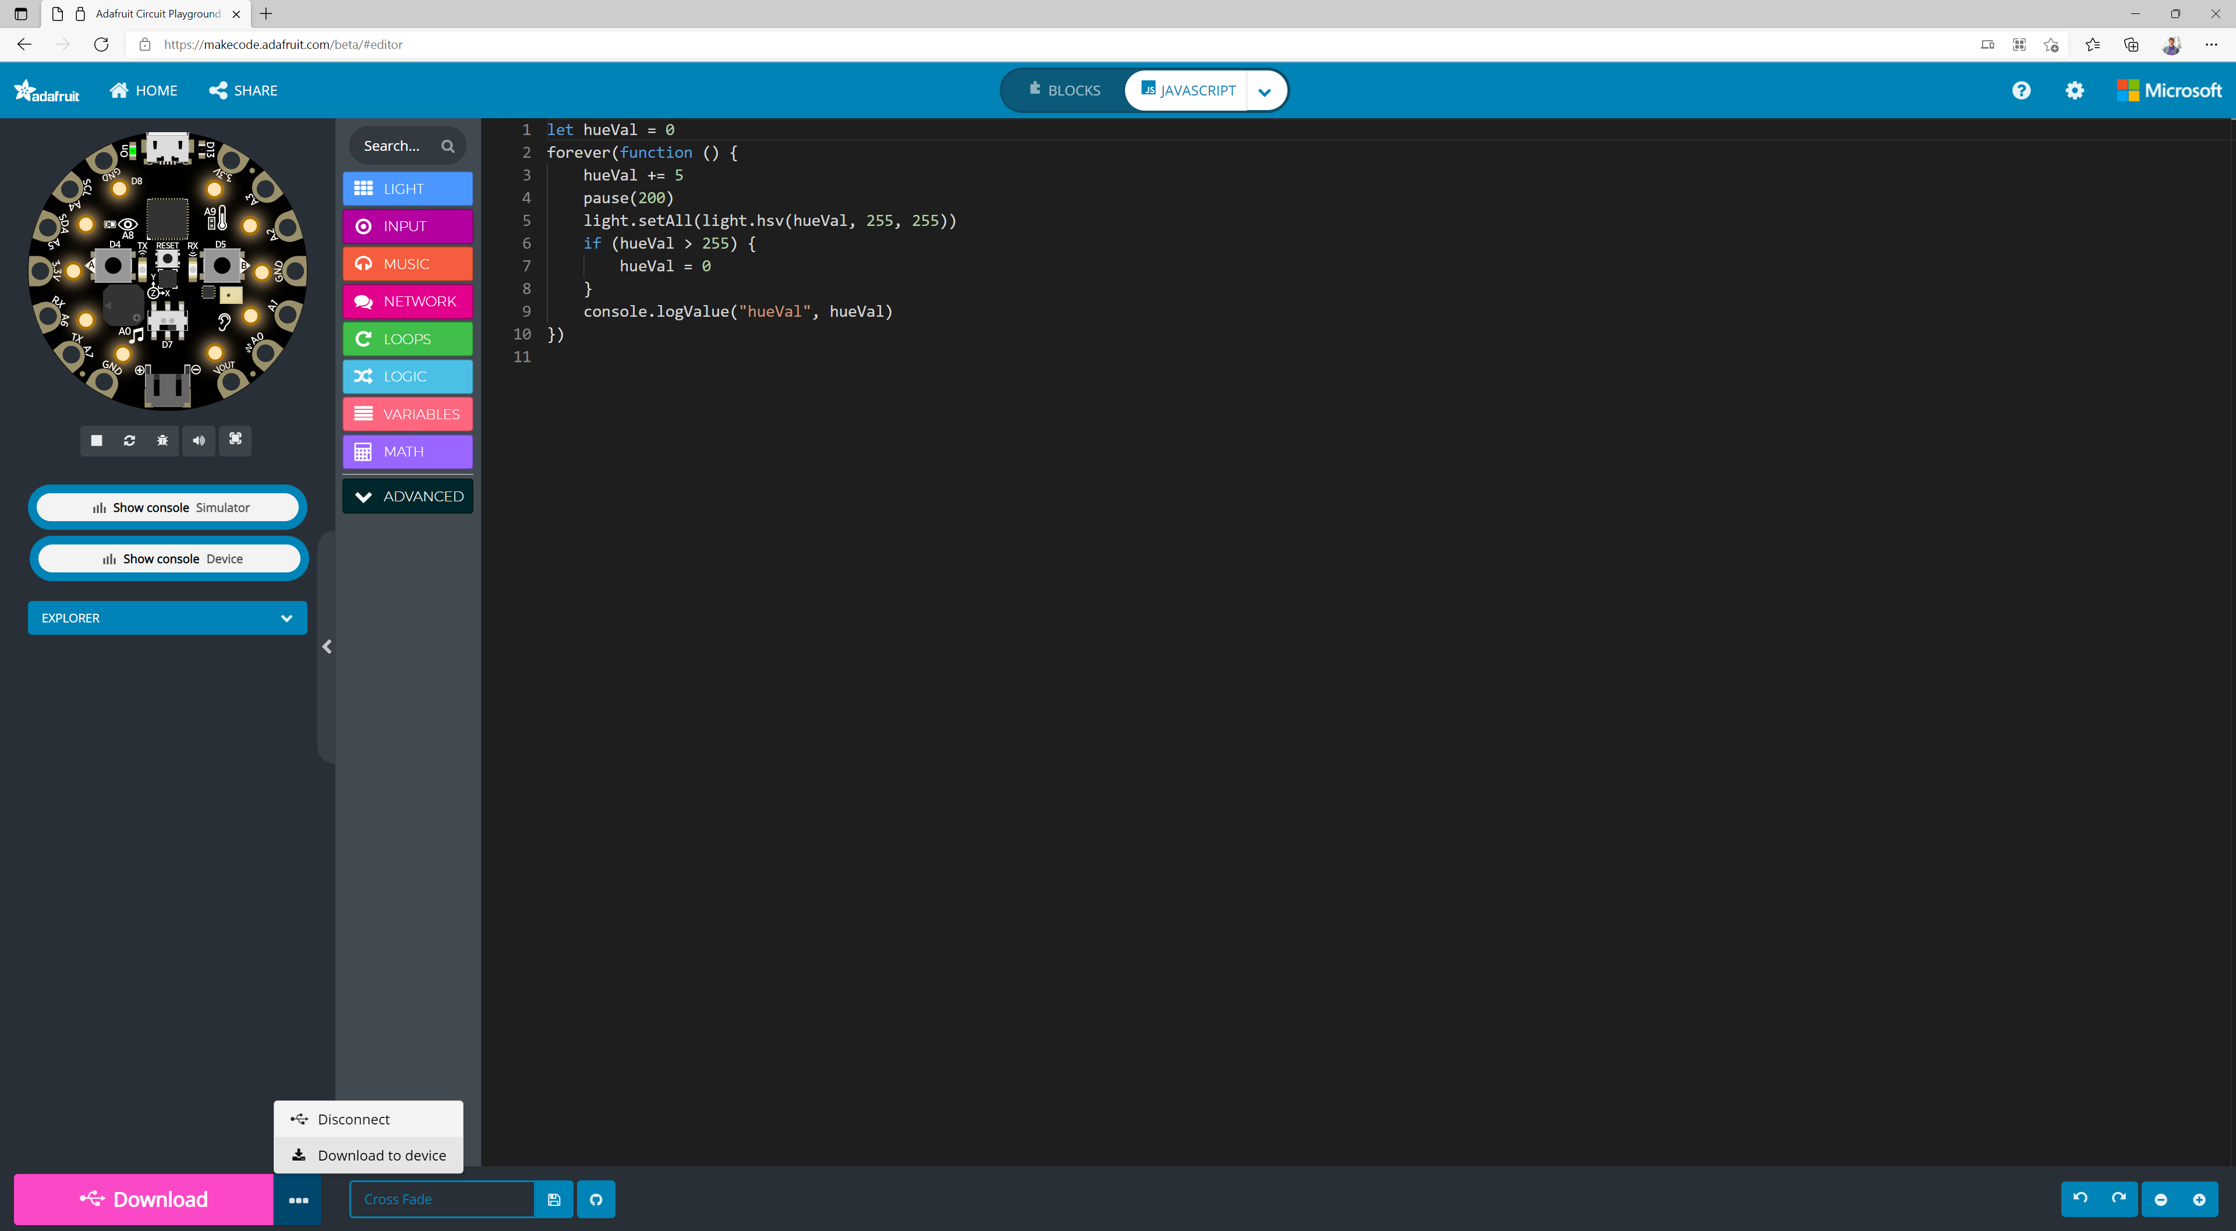

Slide 34
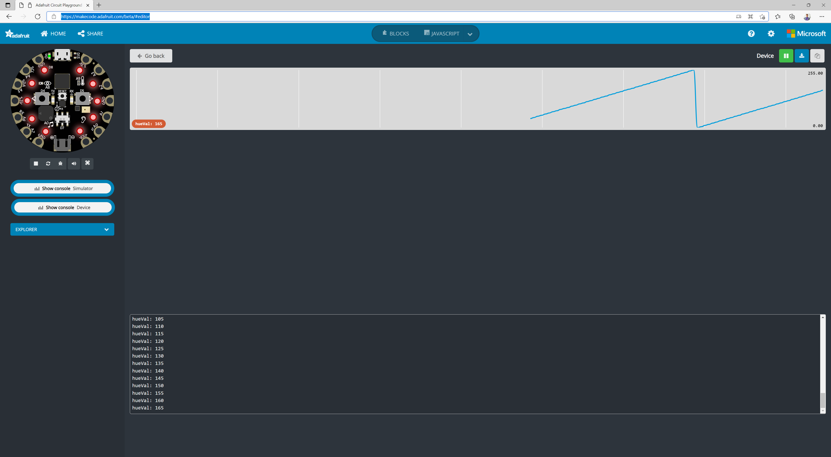
Notes:
Works in Edge too

